Slide 1



Pick a Copy of the Thesis
Find a copy of my thesis
on the handrail
Find a copy of my thesis
on the handrail

Slide 2

Towards Declarative Specification of Static Analysis for Programming Tools
Idriss Riouak
Doctoral Defence
22-11-2024
Notes:
Ok, now we can start.
First of all, thank you Coen for the very nice presentation and for being here today. I would also like to thank the committee for being here and for finding the time to read my thesis.
Today I will try to summarise 5 years of work in this presentation titled: …

Slide 3
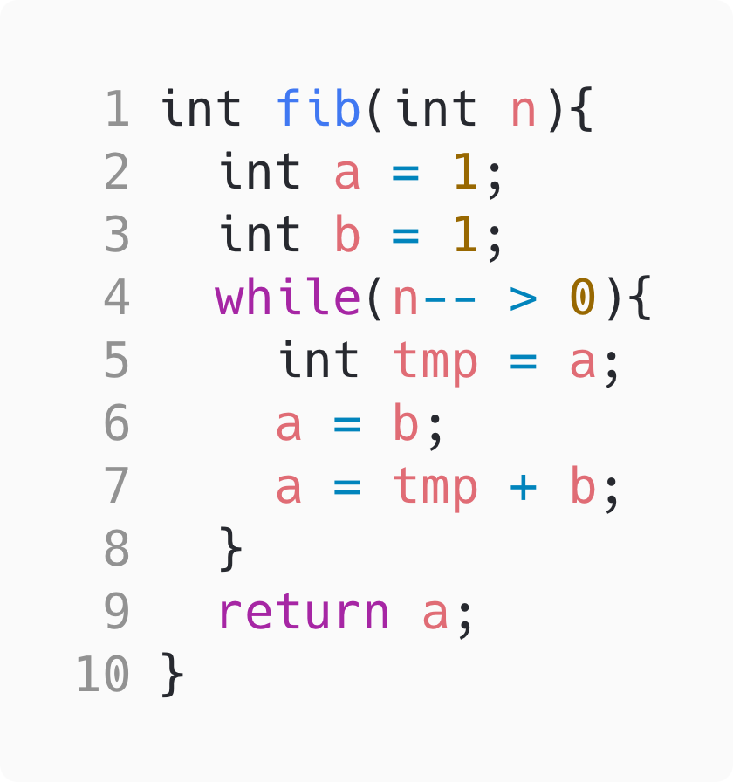
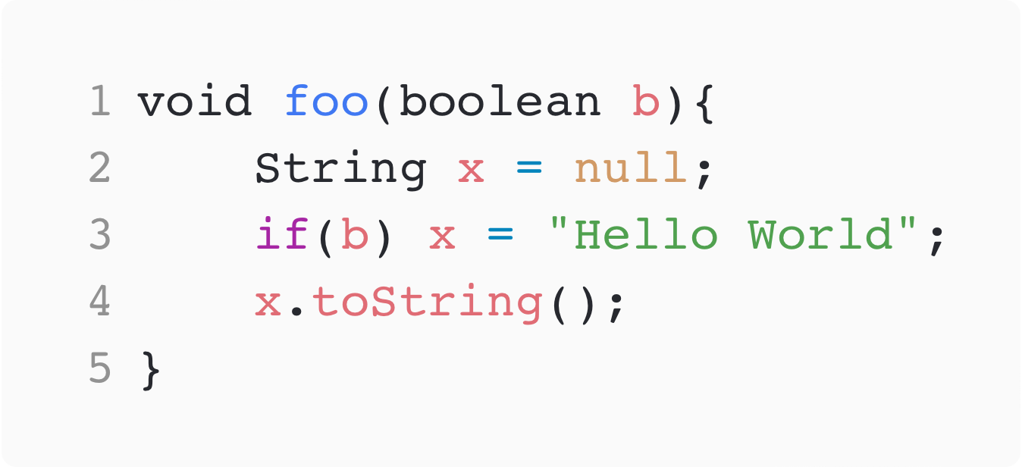

Static Analysis is Everywhere !
We can use static analysis to detect, e.g., common weaknesses:
CWE-476
🐞
‘a=b’ is dead.
🐞
‘x’ might be null
CWE-563
4
Notes:
Static Analysers are everywhere, and if you have ever coded anything, you might have used them in different ways, for instance, detect bugs in our code.
For example, let’s consider, the following piece of code which is supposed to compute the n-th number of the fibonacci sequence. But there is an error in the code. A good static analyser would tell use that The assignment at line 6 is dead”
Let us consider this other example, where depending ot the value of b we might get a null pointer exception. If b is false, we never initalise x and when we tri to access the method toString we get a null point exception. Also here, a good static analyser would tell us that that.

Slide 4





Static Analysers Closer to the Developer
👩‍💻
CI/CD Pipeline
CI/CD Pipeline
Demand-driven evaluation
Only computes results needed for a query
Immediate feedback
Exhaustive Evaluation
The entire codebase is analysed
Delayed feedback
OUR GOAL: response time around 0.1 seconds*.
*Perceive the system as reacting instantaneously.
We used JastAdd: A Reference Attribute Grammar System
5
Notes:
During my PhD I focused on moving the static analyser closer to the developer: why ? Because nowadays static analyzers are run offline on a remote sever as part of the CI/CD pipelin and the feedback to the developer is delayed by hours if not even days.
Why? well because the static analyser will perform an exhaustive evaluation
On the other hand, if move the static analyser closer to the developer, we can reduce context switch overhead, which implies that fixing bug is less errorprone. So we improve productivity.
In order to do so, we need to use a demand driven approach
And our goal is that the static analyser should run in around 0.1 seconds.

Slide 5
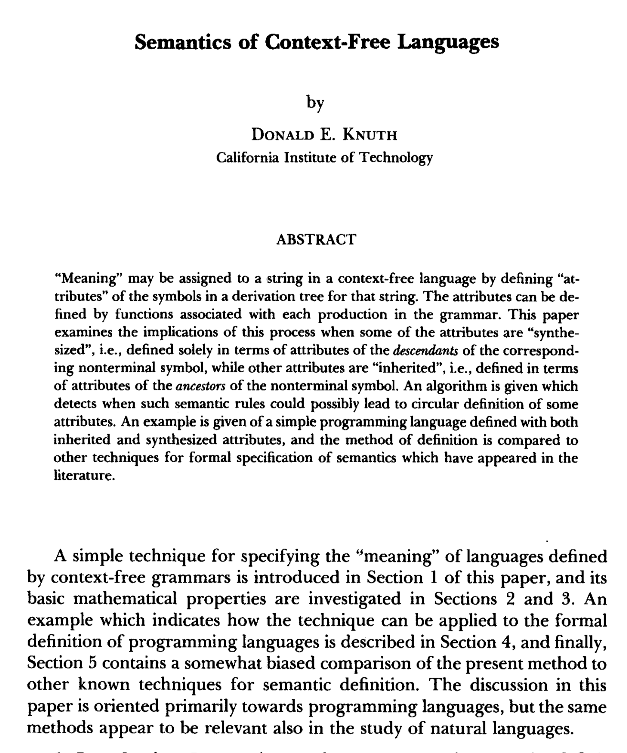
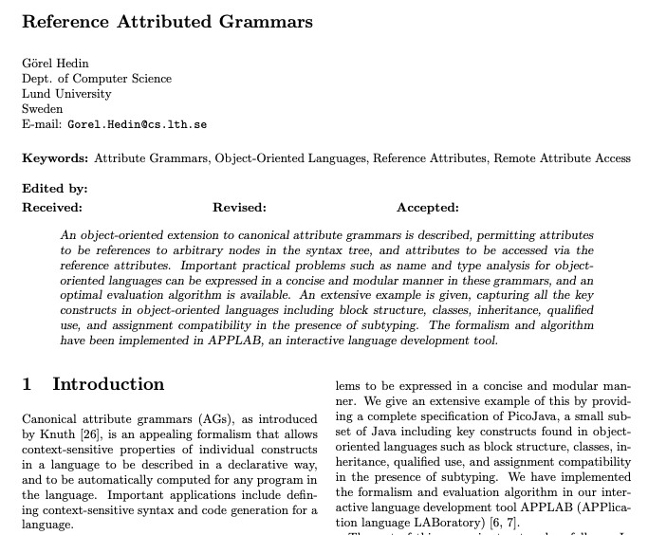
Attribute Grammars
Attributes are derived properties associated to AST nodes.
fib
[1968]
int a = 1
int b = 1
while
return a
[2000]
n-- > 0
int tmp = a
a = b
a = tmp + b
isDead
: true
Properties are declaratively specified with equations and solved automatically
6
Notes:
And then extended to the OO paradigm by GH
To show you how attributes look like, I will give you a practical example
Given this piece of code (which is our broken fibonacci method), we can construct it's tree representation. This tree is called AST.
Now, attributes are properties that we can derive from the AST and attach them to different node in this tree. For eaxmple, a property that we can derive is knowing if an assignment is dead.
For attributes we can compute values, which in this case is “True”. Attribtues can compute values, like boolean, interger, but a value for an attribute can also be a reference to other AST nodes. This allow us to create graphs on top of the AST.
Peropeties like these are declaratively defeined by equations and there is is an automatic machinery that will solve the equation system.

Slide 6
JastAdd: A Reference Attribute Grammar System
JastAdd supports RAGs.
Some examples of projects that use JastAdd:
ExtendJ: Java 11 compiler
IntraJ: Intraprocedural dataflow analysis
Bloqqi: Visual automation language
JModelica: Industry-strength Modelica compiler
...
7

Slide 7
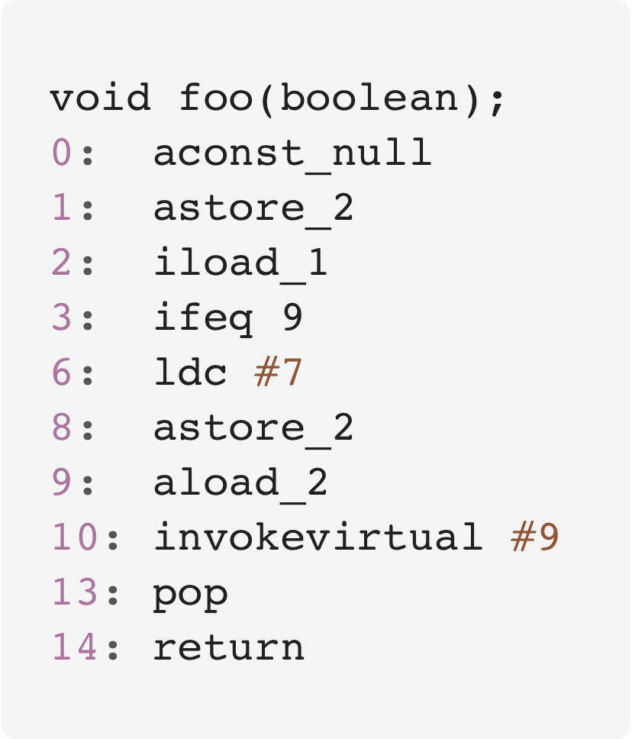
Going back to Static Analysis
Many analyses depend heavily on the Control Flow Graph
Entry
String x = null
b
Entry
True
0
x = “Hello World”
False
1
x.toString()
2
True
Exit
3
6
Intraprocedural CFGs without considering method interactions.
Built from source code to support IDE-integrated analyses.
False
8
9
10
8
13
14
Exit
Notes:
The program analyses we are interested in rely on a data structure known as CFG
The cfg is an overapproximation of all the possible path in your program.

Slide 8
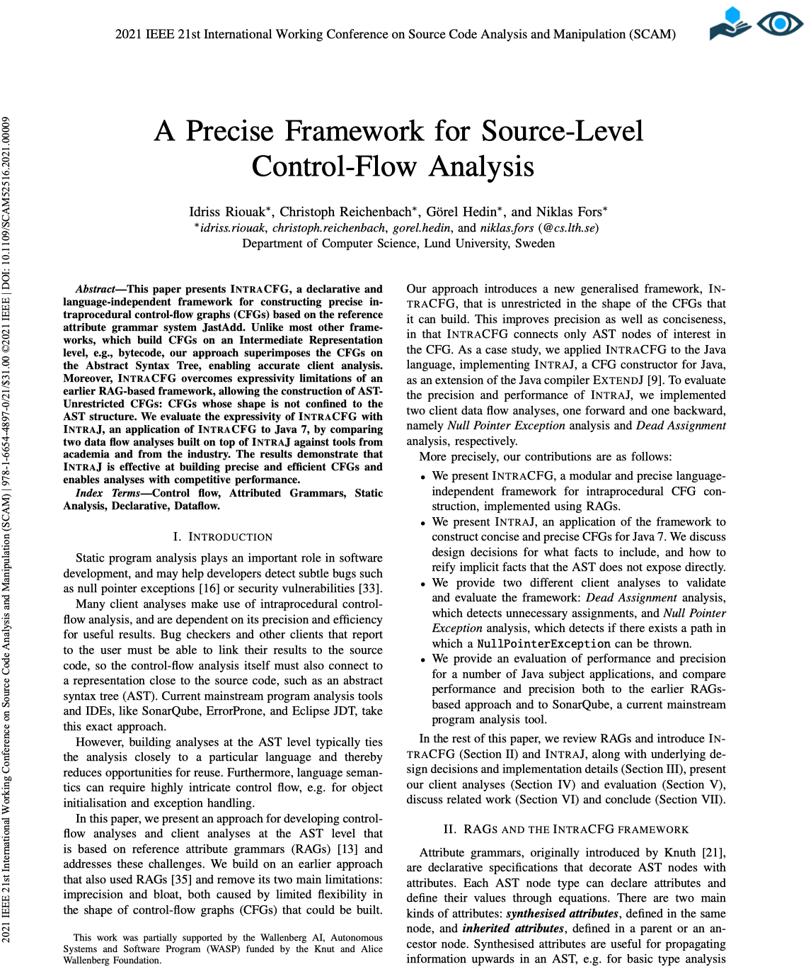
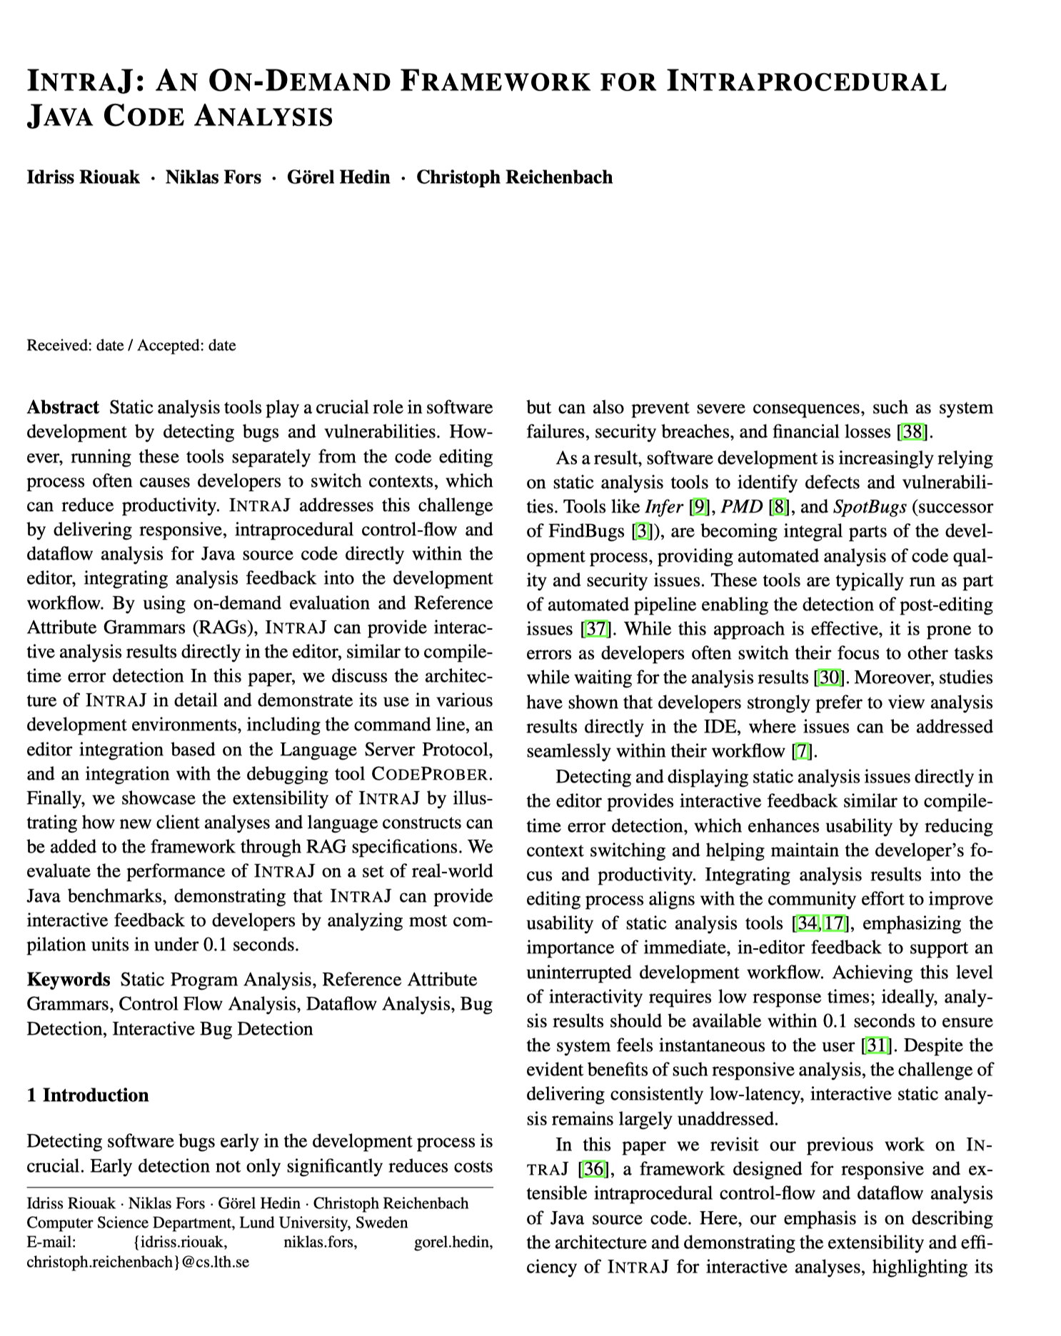
Paper I & Paper II
IntraCFG
Language agnostic framework
Construct CFGs on top of the AST
Declarative specification
IntraJ
Instance of IntraCFG for Java
Intraprocedural CFGs
Five dataflow analyses
Performance & Precision
9

Slide 9
IntraCFG & IntraJ
IntraCFG is a language independent framework for Control Flow Graph Construction. IntraJ is our instance of IntraCFG for Java
Entry
foo
Exit
succ
String x = null
IF
Dot
Entry
String x = null
b
b
=
x
toString()
True
x = “Hello World”
False
x.toString()
x
“Hello World”
Exit
10
Notes:
We will represent the control flow graph defining the Successor relation as an attribute, which allow us to travers the cfg forward.
The developer who wants to support the cfg construction for a specific language will have to define the successor relation for each possible construct in the language.
Sometimes we want to traverse the CFG backwards, so we need the predecessor relation.
The pred is automatically derived by the framework

Slide 10
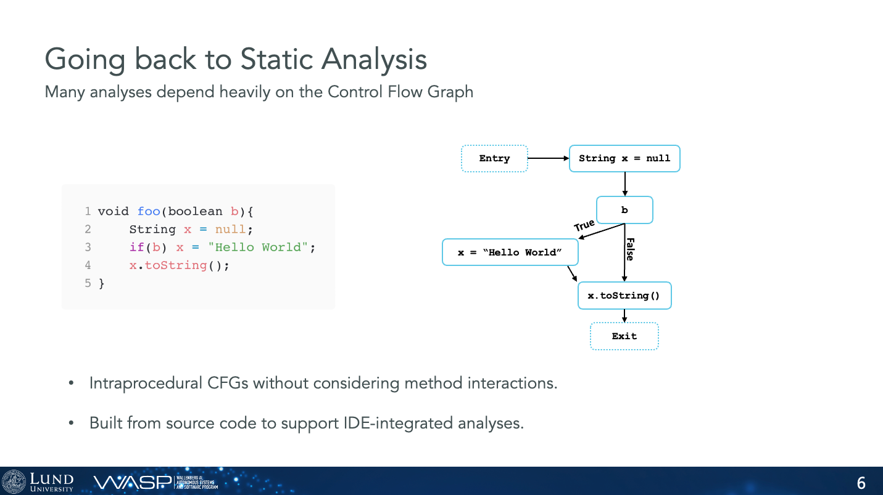
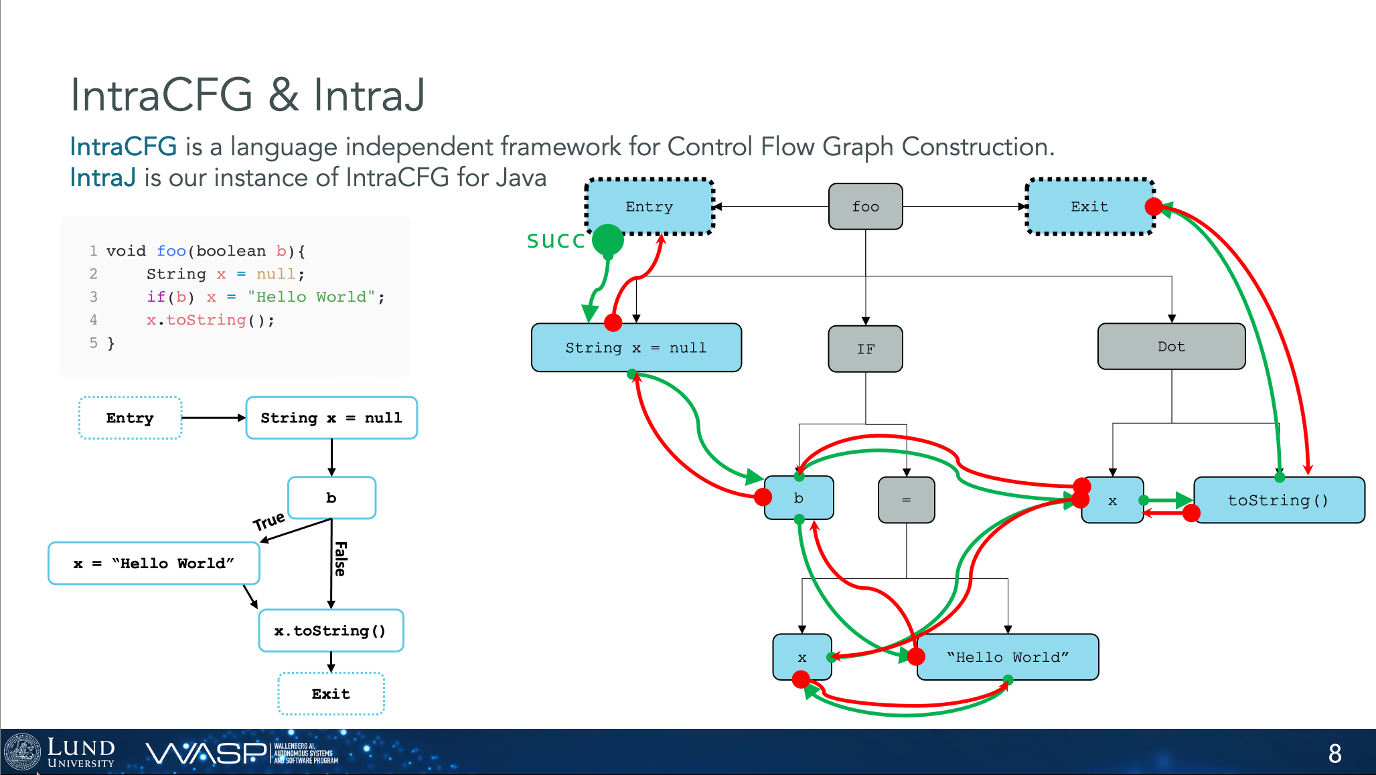
Design Decisions:
The Control Flow Graph is constructed on the Abstract Syntax Tree
No bytecode generation overhead
2: Only relevant nodes are part of the CFG:
Nodes like IfStmt, While, Dot are not part of the CFG
3: The CFG is computed on-demand
11

Slide 11
Demand-driven evaluation
Entry
foo
Exit
cached 💾
String x = null
IF
Dot
cached 💾
b
=
x
toString()
cached 💾
cached 💾
isNullable: ?
x
“Hello World”
cached 💾
12
Notes:
We have to traverse backward the CFG and see if there is a path where the null values reaches X

Slide 12
Demand-driven evaluation
Entry
foo
Exit
cached 💾
String x = null
IF
Dot
cached 💾
b
=
x
toString()
cached 💾
cached 💾
isNullable: true
x
“Hello World”
cached 💾
13
Notes:
Now the question is, how good is IntraJ ?

Slide 13
How to Assess the Quality of a research Project ?
Three factors that we have to consider:
Benchmark Selection
Precision
Performance
14

Slide 14
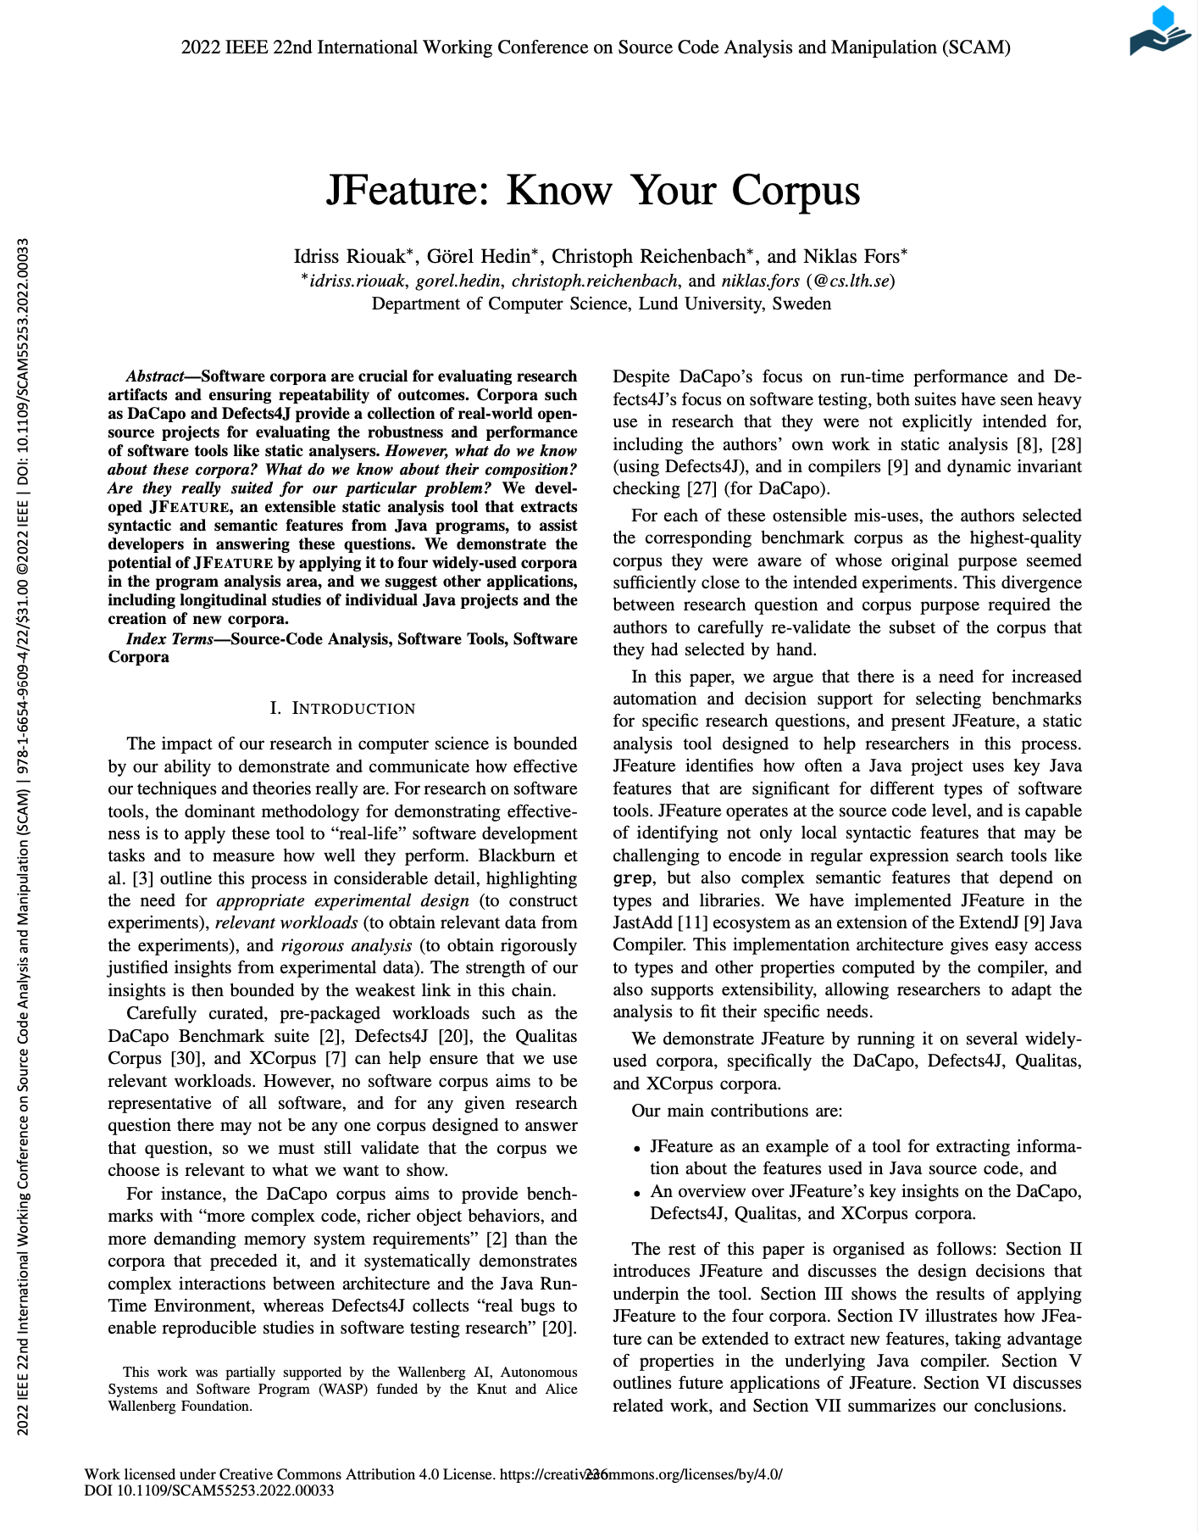
Paper III
JFeature can be used for decision support when selecting benchmarks for Java
JFeature extracts syntactic and semantic features (anything a compiler can compute)
For instance:
Use of strictfp
Use of Lambda expressions
Takeaway: researchers should carefully select a corpus before using it.
15
Notes:
Decision support tool for selecting benchmarks for specific research questions for Java
Separate future work and separate artifact from paper.
SRC programming 2024
Remove graph.

Slide 15
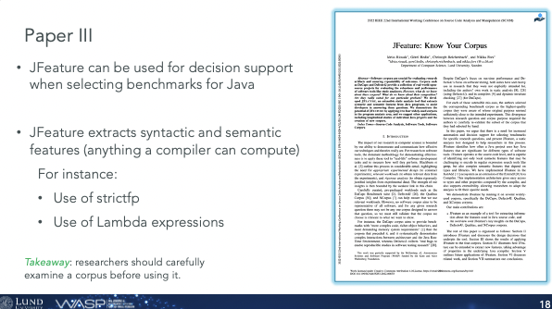
How to Assess the Quality of a research Project ?
Three factors that we have to consider:
Benchmark Selection
Precision
Performance
16

Slide 16



Evaluation
We compared IntraJ’s results against:
SonarQube: an industrial and quite popular static analyser.
We evaluated the precision of two dataflow analyses:
Dead Assignment Analysis
Null Pointer Dereference Analysis
4 Benchmark projects:
ANTLR
PMD
JFC
FOP
40KLOC
100KLOC
17

Slide 17
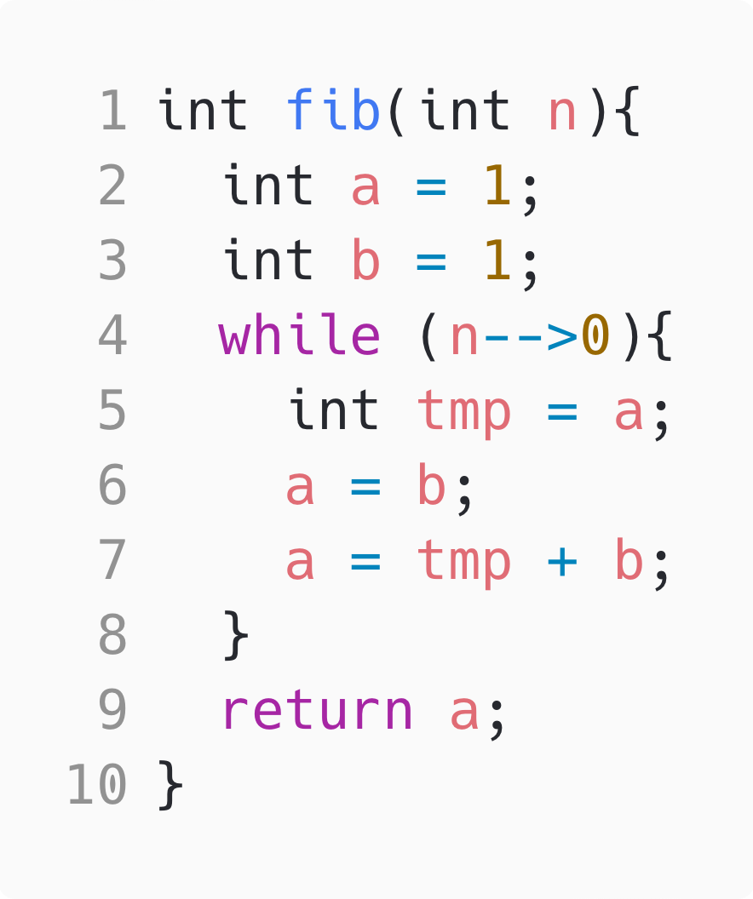
Precision Results:
Dead Assignment Analysis
Benchmark | IntraJ |  | Both |  | SonarQube
 | TP | FP | TP | FP | TP | FP
ANTLR | 9 | - | 112 | - | - | -
PMD | 4 | - | 20 | - | - | 8
JFC | 2 | - | 87 | 1 | - | -
FOP | 95 | - | 156 | - | - | 44
🐞
‘a=b’ is dead.
Takeaway: IntraJ is more precise than SonarQube for Dead Assignment Analysis.
Null Pointer Dereference Analysis
Benchmark | IntraJ |  | Both |  | SonarQube
 | TP | FP | TP | FP | TP | FP
ANTLR | 7 | 4 | 4 | - | - | -
PMD | 6 | - | 7 | - | 3 | -
JFC | 14 | 3 | 188 | - | - | -
FOP | 17 | 5 | 21 | 3 | - | -
🐞
‘x’ might be null
Takeaway: IntraJ reports some false positives but, in most cases, detects more than SonarQube.
18
Notes:
The cfg is an overapproximation of all the possible path in your program.
IntraJ is more precise that SonarQube.

Slide 18
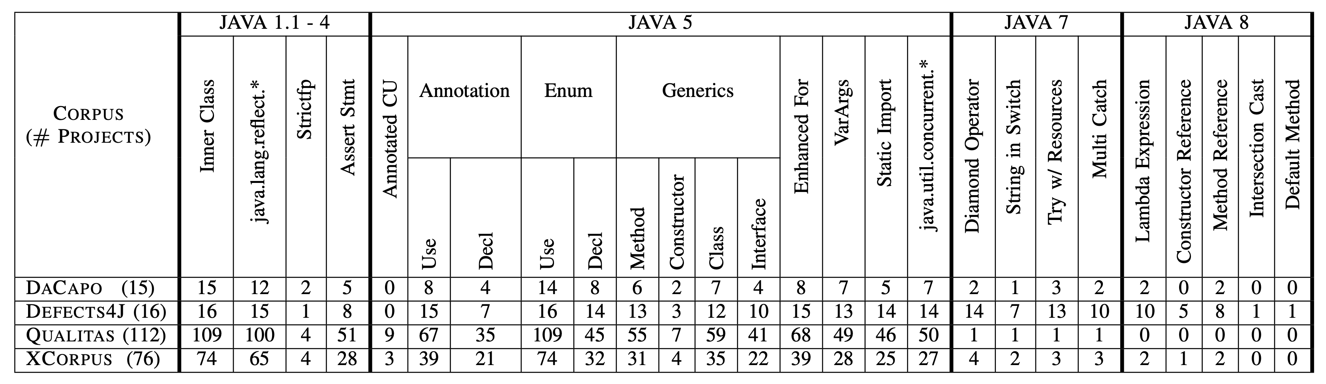
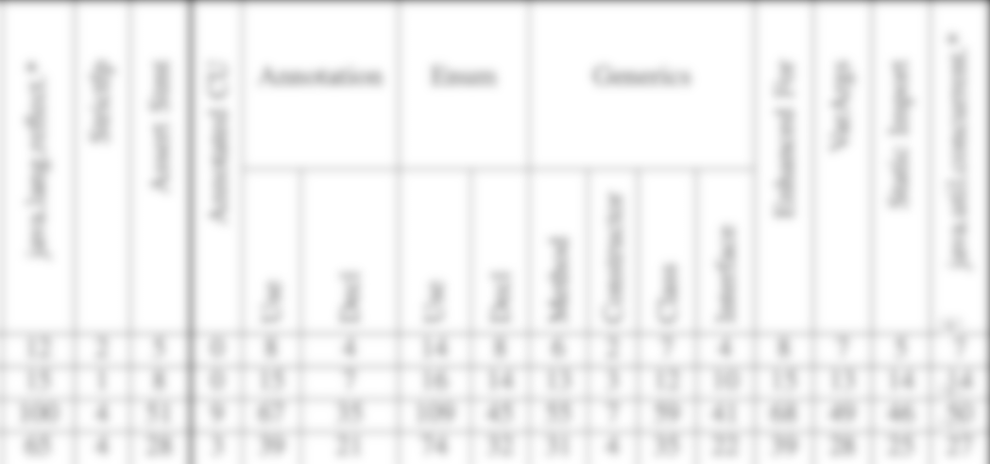
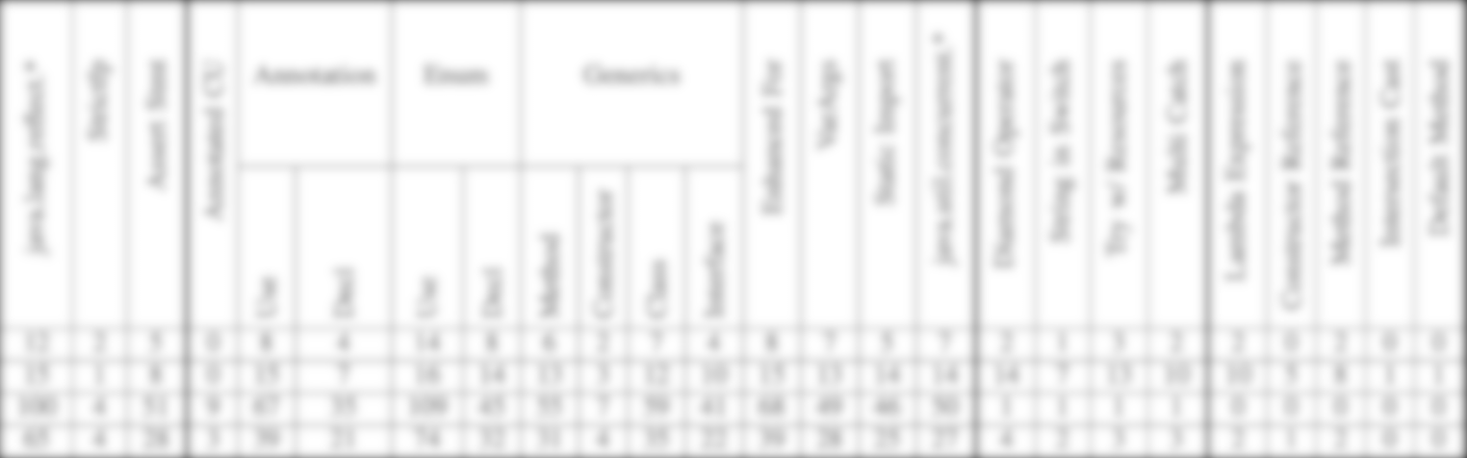


Empirical Results of four well-known corpora
DaCapo
Performance
# Projects: 15
2039 citations
Defects4J
Static Analysis
# Projects: 16
1495 citations
XCorpus
Dynamic Language Feature
# Projects: 76
44 citations
Qualitas Corpus
Static Analysis
# Projects: 112
503 citations
Takeaway: researchers should carefully examine a corpus before using it.
19
Notes:
Decision support tool for selecting benchmarks for specific research questions for Java

Slide 19
How to Assess the Quality of a research Project ?
Three factors that we have to consider:
Benchmark Selection
Precision
Performance
20

Slide 20
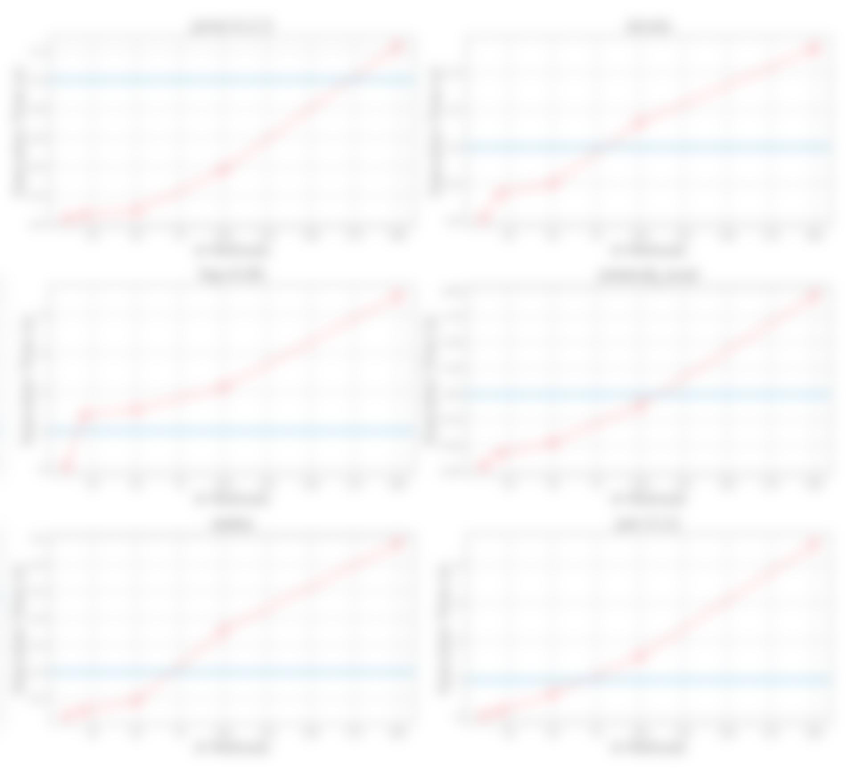
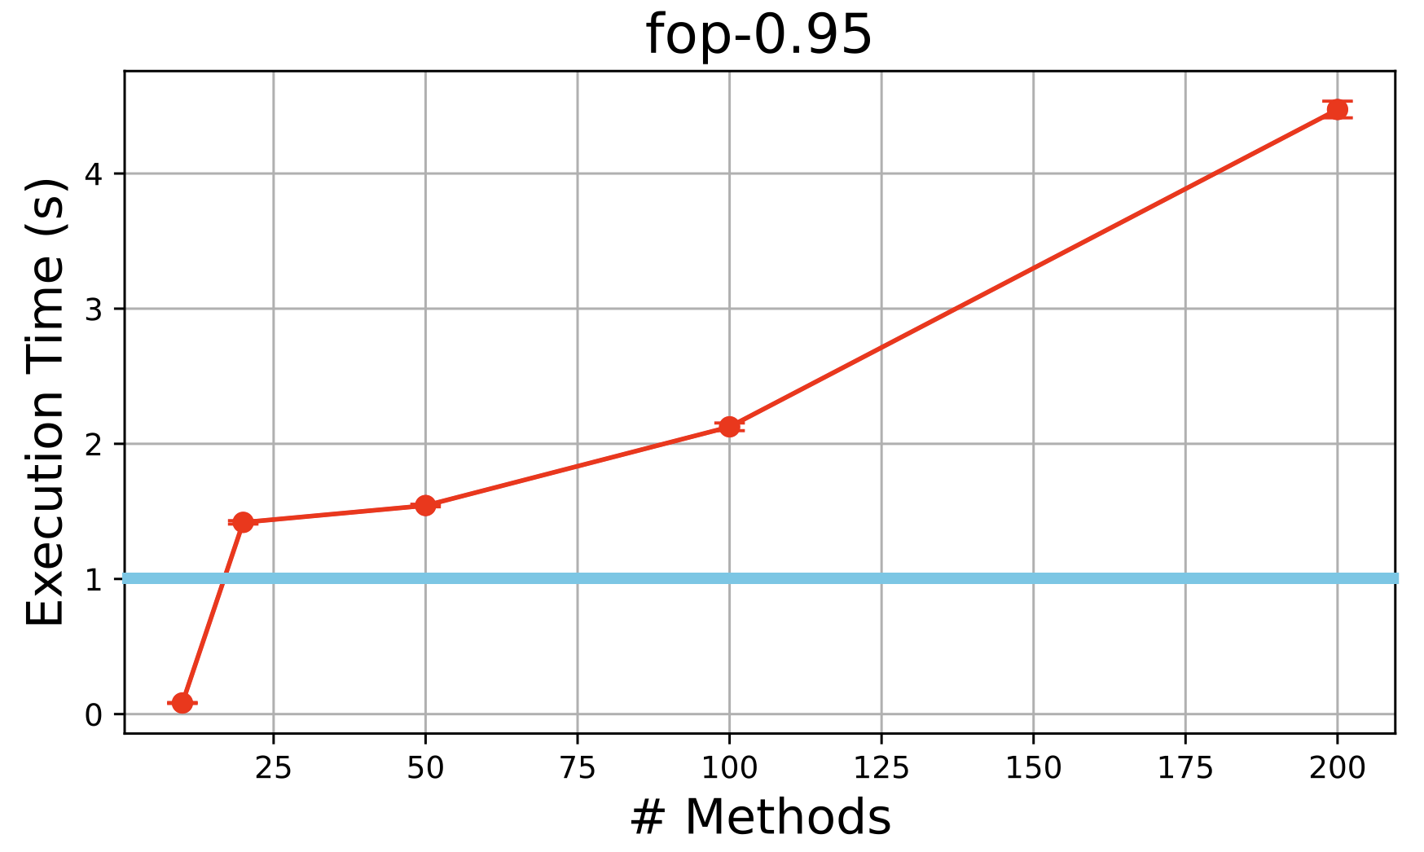
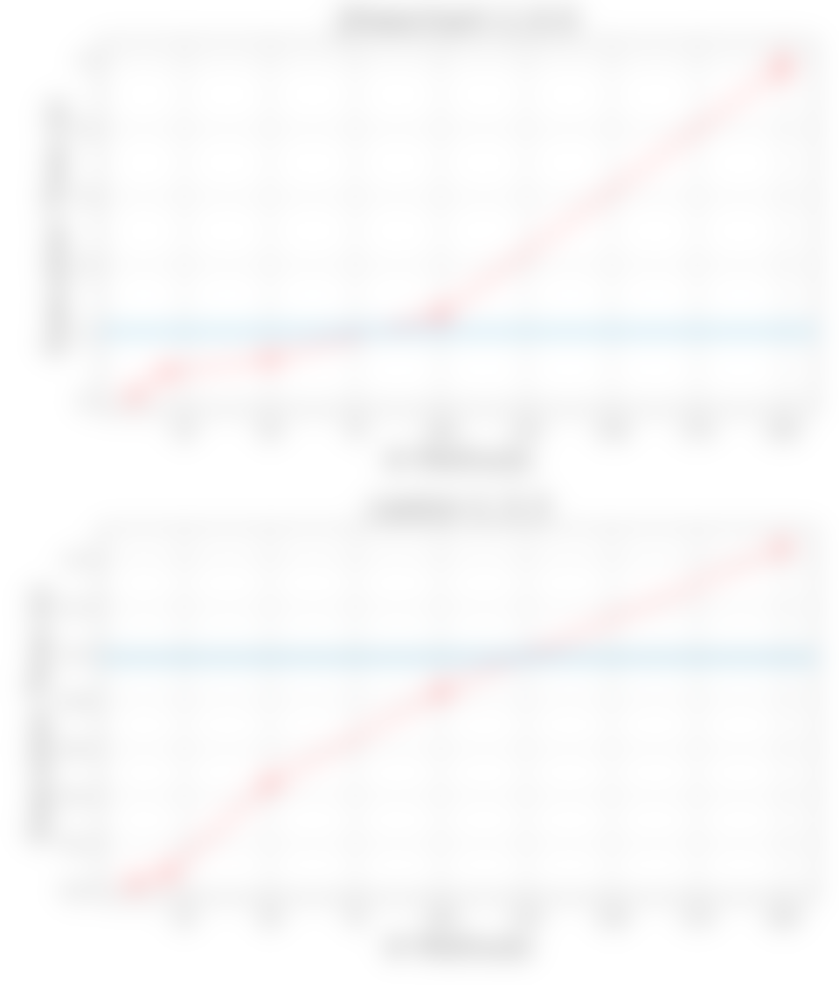
Is this fast enough ?
Mhhh! We can do better.
Randomly selected
methods:
We analysed 10 – 20 -50 - 100 – 200 methods.
Results for Null-pointer dereference
21
Notes:
Here we are simulating an interactive use, we we analyse 10-20 .. 200 methods.
I added a blue line at 1 second because all these graphs have different y-axis.
That's too slow for interactive uses.

Slide 21
Let’s change the focus!
22

Slide 22
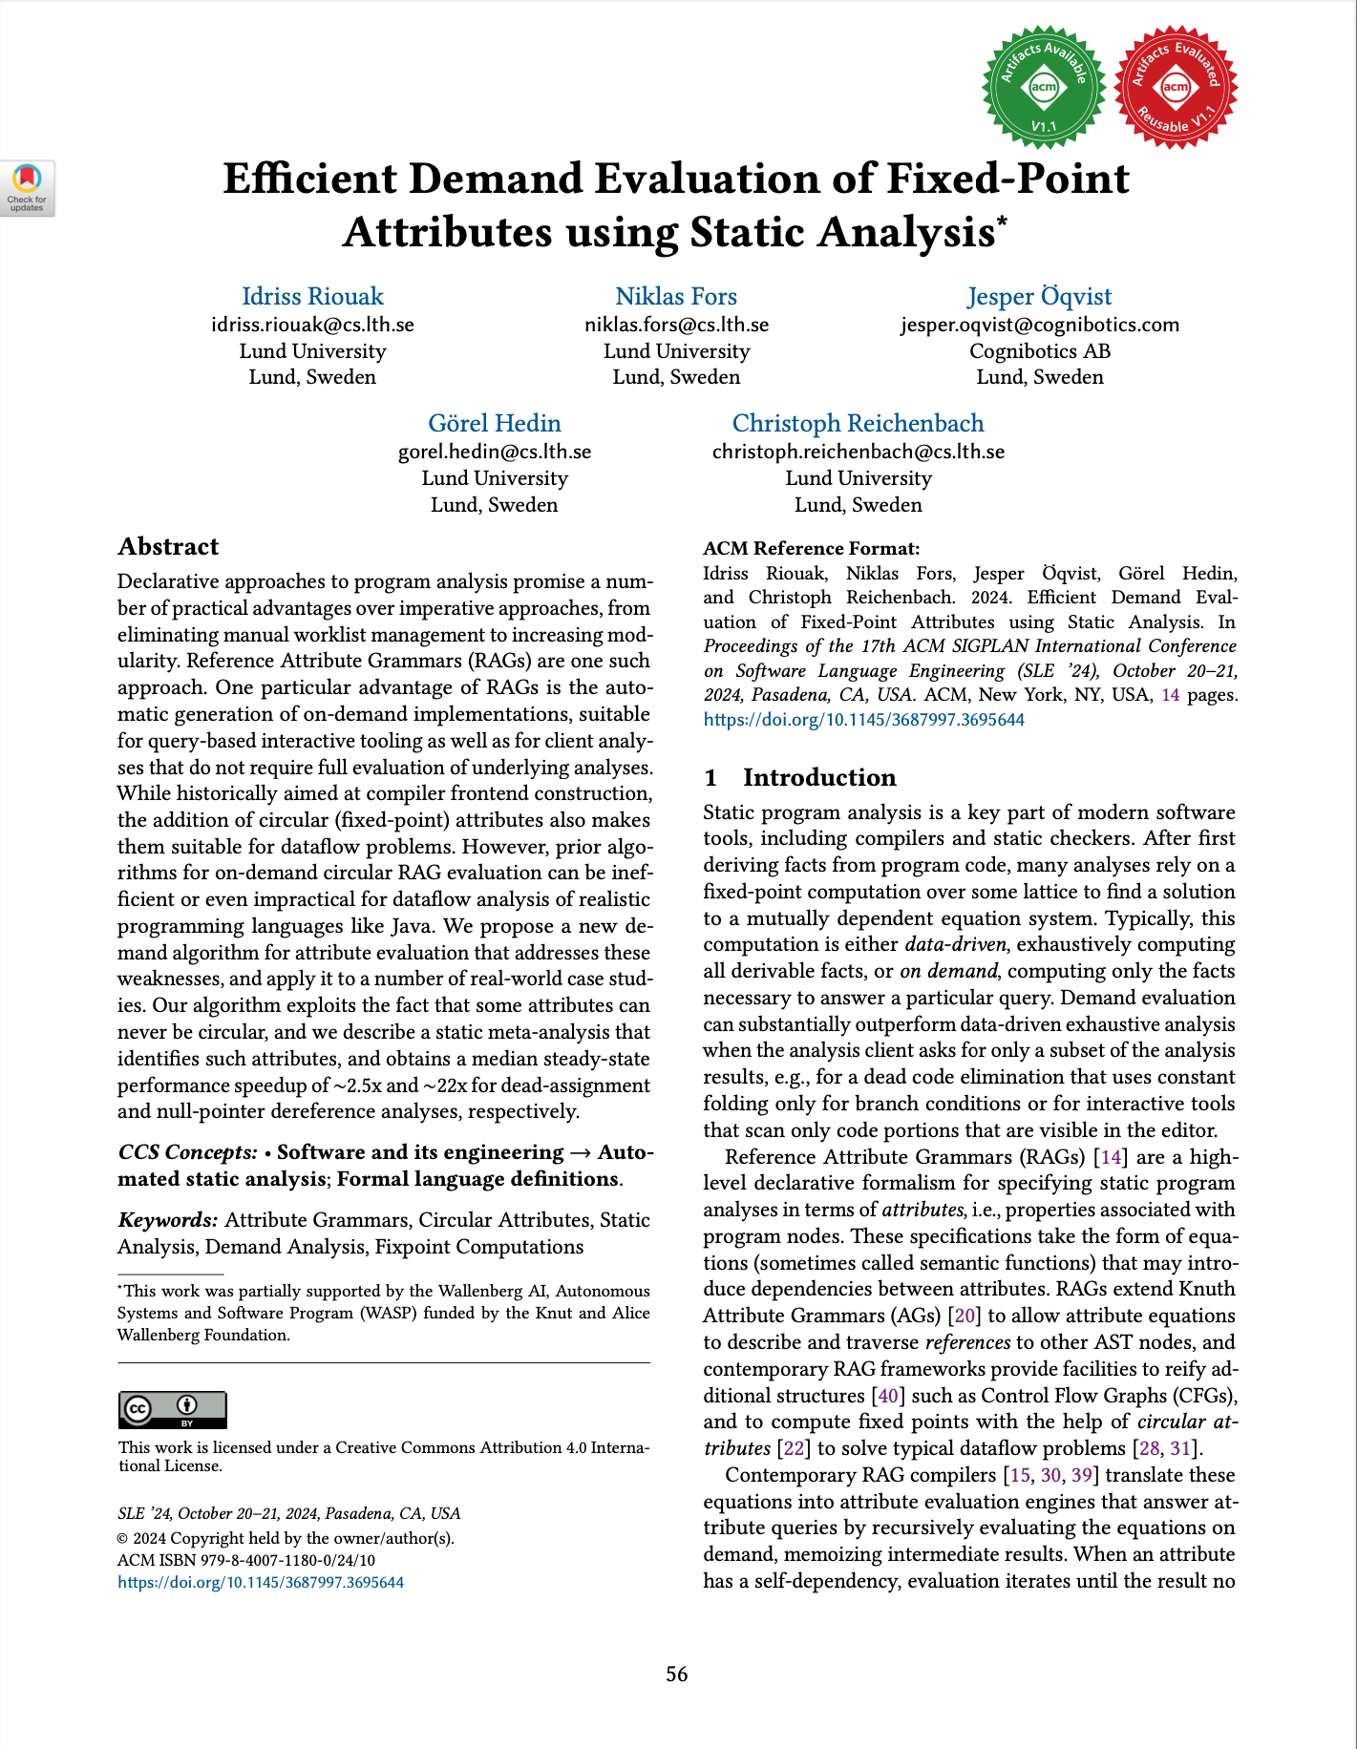
Paper IV
Using static analysis to improve the efficiency of static analysers.
23
Notes:
Before continuing with the contribution of this paper, I would like to talk about how these dataflow analysis look like.

Slide 23
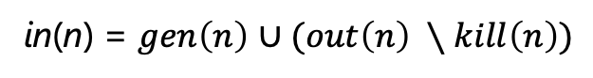
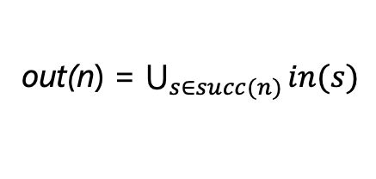
Dataflow Analysis
Most dataflow analyses are instances of the monotone framework.
These are the textbook equations for backward dataflow analysis.
isDead
in
out
in(n) = $gen\left(n\right)$ $∪(out\left(n\right) ∖kill\left(n\right))$
out(n) = $\bigcup_{s∈succ(n)}{in(s)}$
gen
kill
succ
Each of these functions can be implemented as an attribute.
24
Notes:
if we take the Dragon book - bible of compiler engineers- and we open the chapter about dataflow analyses.
I would like to draw the static dependency graph between the functions in these two equations.
We have that In and Out compute values in terms of Sets. These sets can be sets of Expressions or Variables depending on our analysis. Since we are interested in DAA, we will use a function "isDead" to intepret the result computed by in and out, so that we know if an assignment is dead or not.
This is the static graph. In reality we would have many more instances. Each of these functions can be implemented as attributes
Let's cosndier a concerete example.

Slide 24
Dataflow Analysis with RAGs
Let us consider the following program:
fib
int a = 1
int b = 1
while
...
in
out
in
out
n-- > 0
in
out
int tmp = a
a = b
a = tmp + b
in
out
in
out
in
out
To compute in and out we have to compute a fixpoint! How ?!
Circular Attributes
25
Notes:
We have a while loop and therefore we have a cycle.

Slide 25



How can we efficiently compute a demand-driven fixed-point attribute ?
Year and Author | Support Circular Attributes | Demand-Driven Algorithm | Support RAGs
1968 - Knuth
1986 – Farrow & Jones et al.
1996 – Boyland
2002 – Sasaki & Sassa
2003 – Magnusson et al.
2017 – Öqvist et al.
2024 – Paper IV
Remote Attribute
Remote Links
BasicStacked
⚠️
RelaxedMonolithic
⚠️
RelaxedStacked
26
Notes:
Are basically RAGs but reference are resolved at compile time.
Since our algorithm depends indirectly on the BasicStacked, I will start with this algorithm and I will explain how it works.

Slide 26
The BasicStacked Algorithm
isDead
NC
It supports two kind of attributes:
Circular (C):
Trigger a circular evaluation, i.e, fixed-point computation
Non-Circular (NC):
Not in circular evaluation:
Evaluated and cached immediately
In circular evaluation:
Circular evaluation temporarly paused
Evaluated and cached immediately
The user needs to manually annotate all Circular attributes
in
out
C
C
gen
kill
succ
NC
NC
NC
27

Slide 27
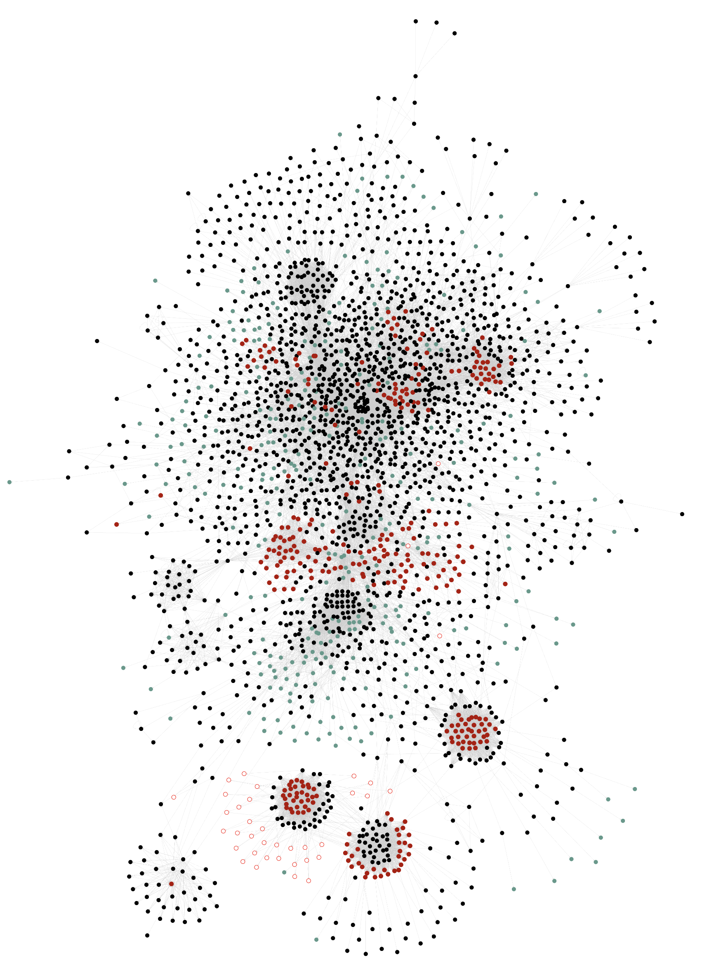
The BasicStacked Algorithm
Main problems:
Some attributes are rarely circular, but we still pay a costly fix-point.
Annotating each attribute is error-prone for large projects.
Complexity of the ExtendJ Java Compiler.
2597 Attributes connected by 26222 edges
28
Notes:
Here we have a snapshow of the static attribute dependencies in ExtendJ. As you can see changing a single attribute here might change the circularity of other attributes.

Slide 28
The RelaxedMonolithic Algorithm
isDead
A
It supports two kind of attributes:
Circular (C):
Trigger a circular evaluation, i.e, fixed-point computation
Agnostic (A):
Not in a circular evaluation:
Behaves as Non-Circular attribute.
In a circular evaluation:
Behaves as a Circular attribute.
At least one Circular attribute in the same cycle.
in
out
C
A
gen
kill
succ
A
A
A
29
Notes:
, i.e., it will be cached only after all attributes in the fixed-point computation reach a fixed-point.

Slide 29
The RelaxedMonolithic Algorithm
Main problem:
After encountering a circular attribute, all subsequent attributes are treated as circular.
Therefore, the fixpoint evaluation is performed in a single monolithic fix point computation
Queried
Evaluated 20 times
isDead
A
Needs 20 iterations
C
in
out
A
Needs 10 iterations
gen
kill
succ
isReachable
reachable
Evaluated once
A
A
A
A
C
30
Notes:
Attributes
C is not red immediatley.
Color intensity.

Slide 30
Our approach: the RelaxedStacked Algorithm
Our new algorithm combines:
Circular
Non-Circular
Agnostic
Algorithm | Supported Attributes | Decompose Static SCCs | Annotation Effort
BasicStacked | Circular Non-Circular | Yes | High
RelaxedMonolithic | Circular Agnostic | No | Low
RelaxedStacked | Circular Non-Circular Agnostic | Yes | ?
Low*
* Using static analysis
Key Idea: If an agnostic or circular is not in a cycle, it can be re-classified as non-circular.
31

Slide 31
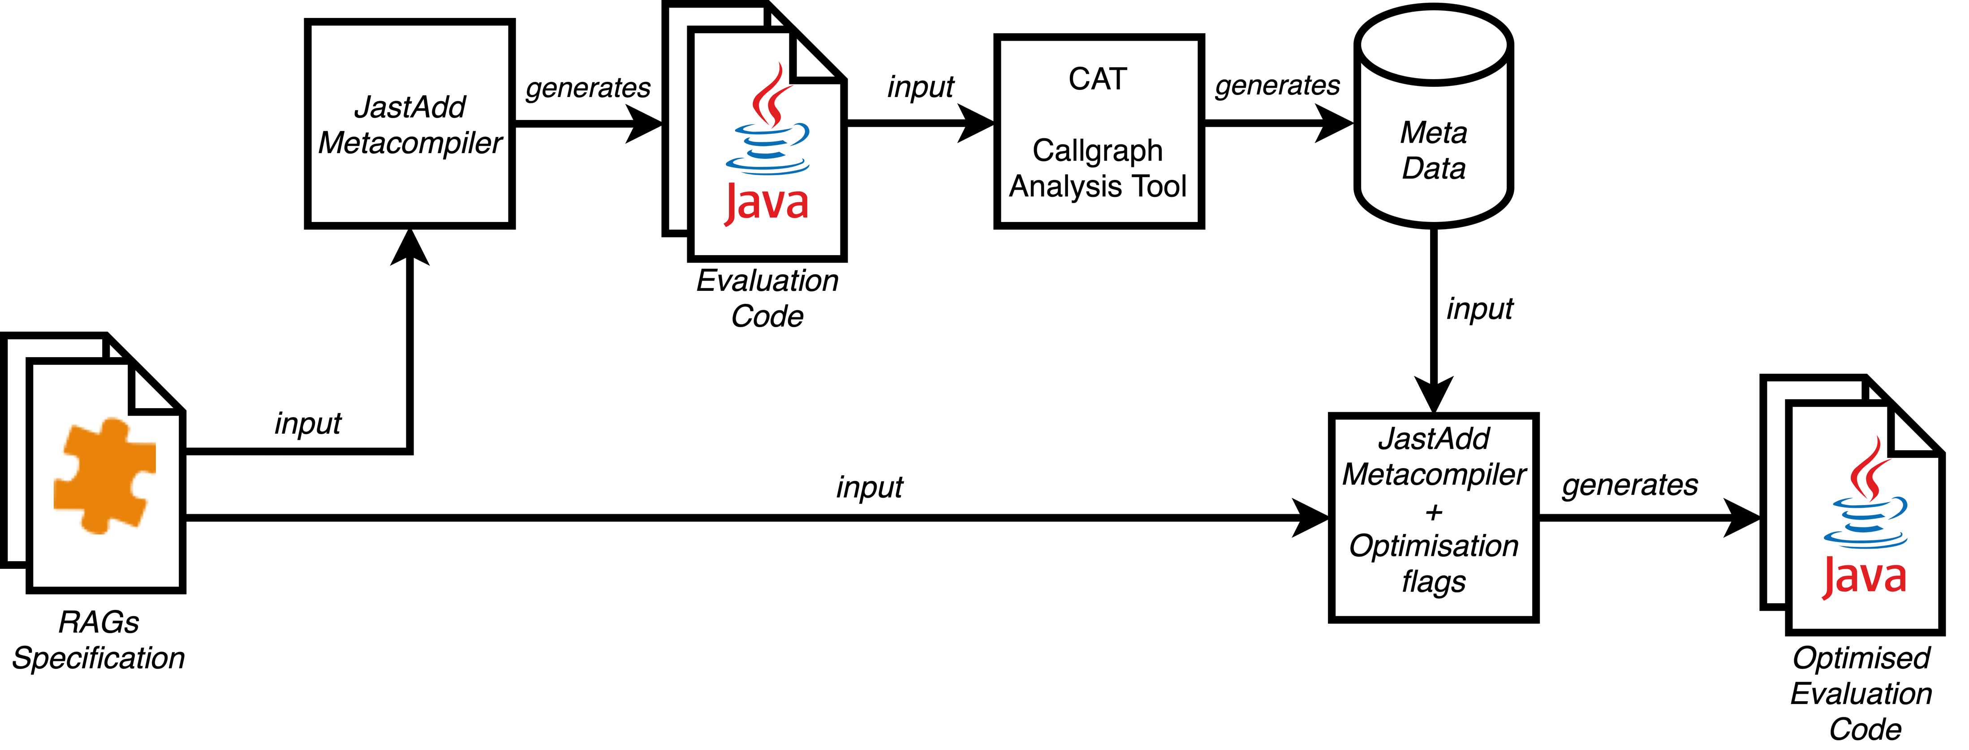
Using Static Analysis to Classify Non-Circular Attributes
32
Notes:
Here is an overview of our apporach

Slide 32
Let’s go back to dataflow
From the Java code generated by JastAdd, we construct the callgraph.
We compute SCCs and identify definitively Non-circular attributes.
Queried
isDead
NC
A
Evaluated 20 times
Needs 20 iterations
C
in
out
A
Needs 10 iterations
gen
kill
succ
isReachable
reachable
NC
NC
NC
NC
C
A
A
A
A
Evaluated once
33
Notes:
A trivial SCC is a SCC with a single node not connected to itself.

Slide 33


Evaluation Overview
We compared our new algorithm, RelaxedStacked, with the two existing algorithms: BasicStacked and RelaxedMonolithic.
Three case studies:
LL(1) parser construction
ExtendJ Java compiler
IntraJ static analyser.
No overhead
34
Notes:
No overhead with fully anotate application like LL1 parser constructions or application with few circular attributes.

Slide 34
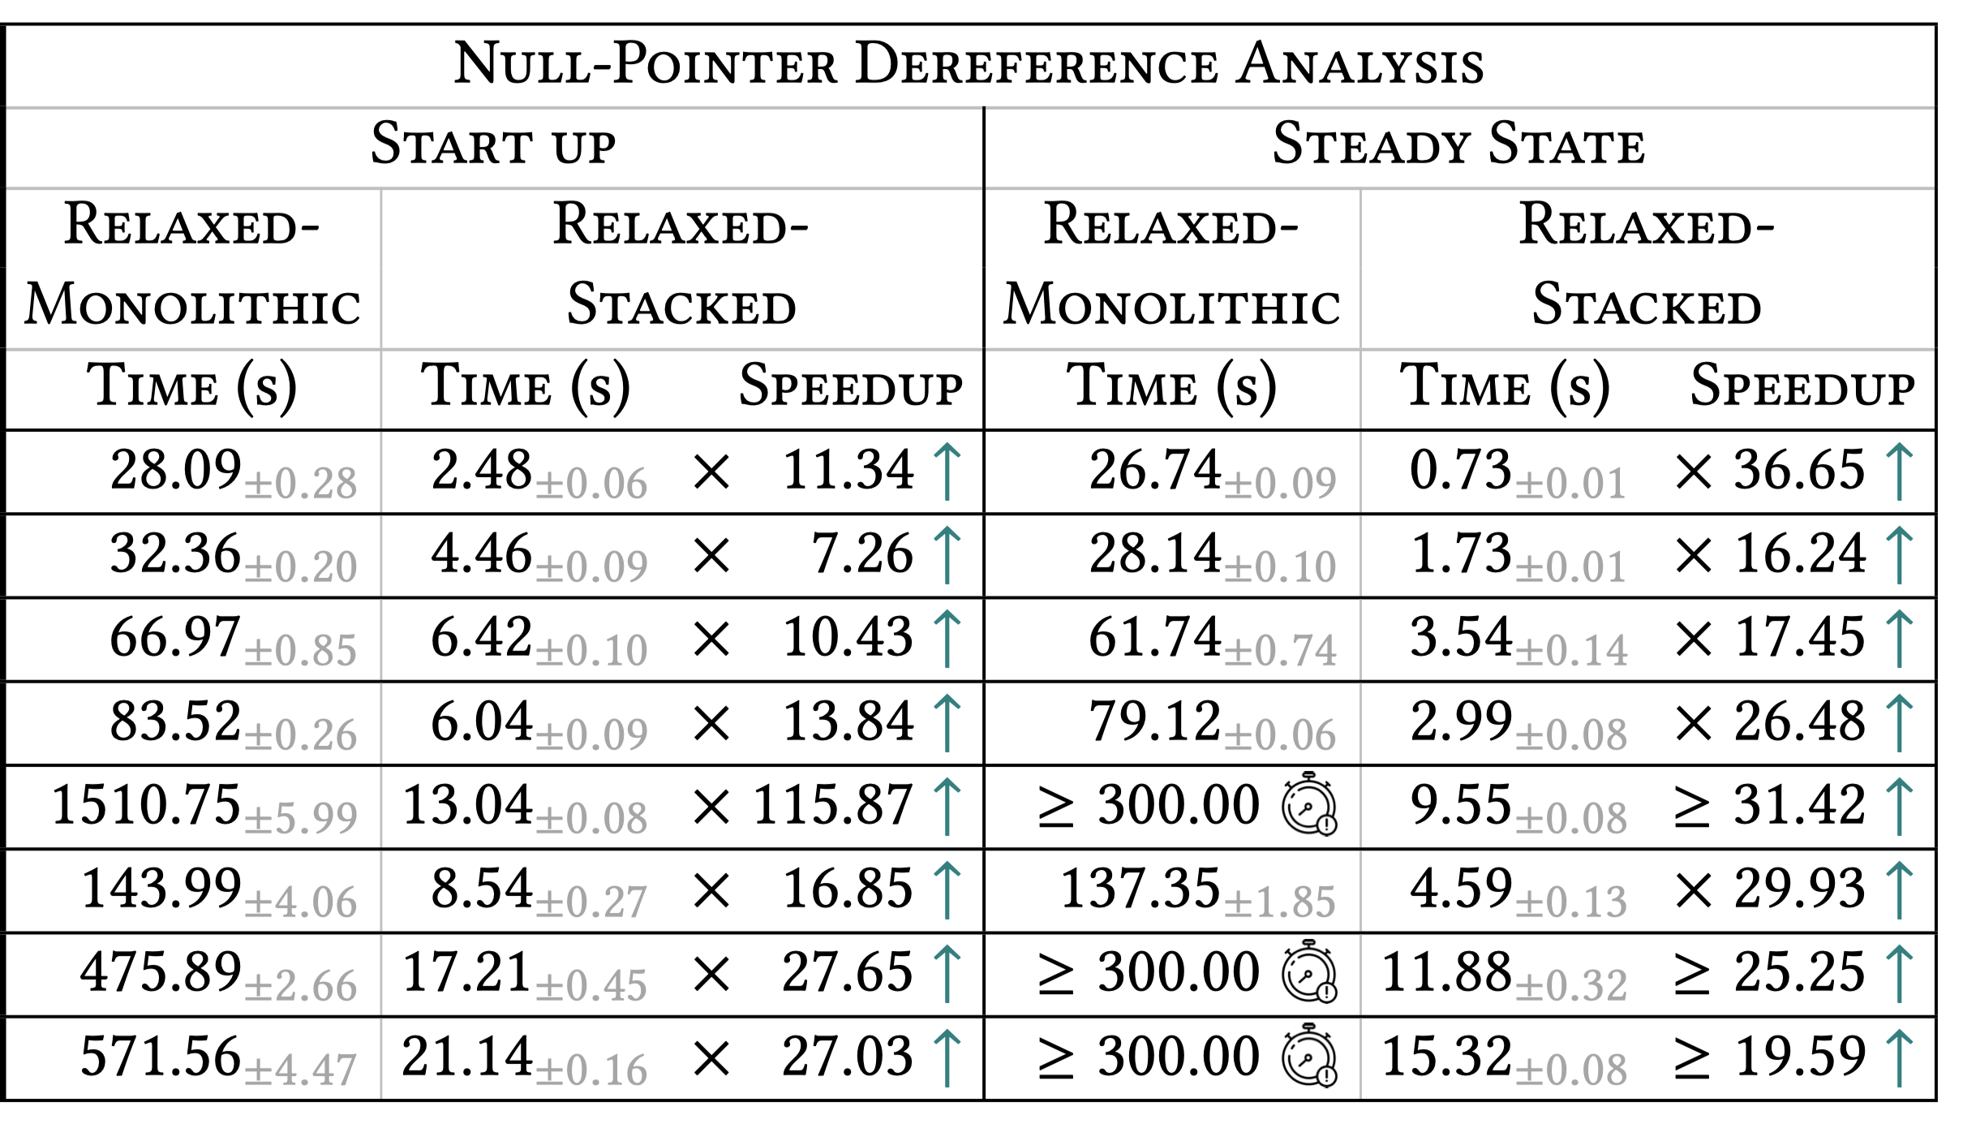
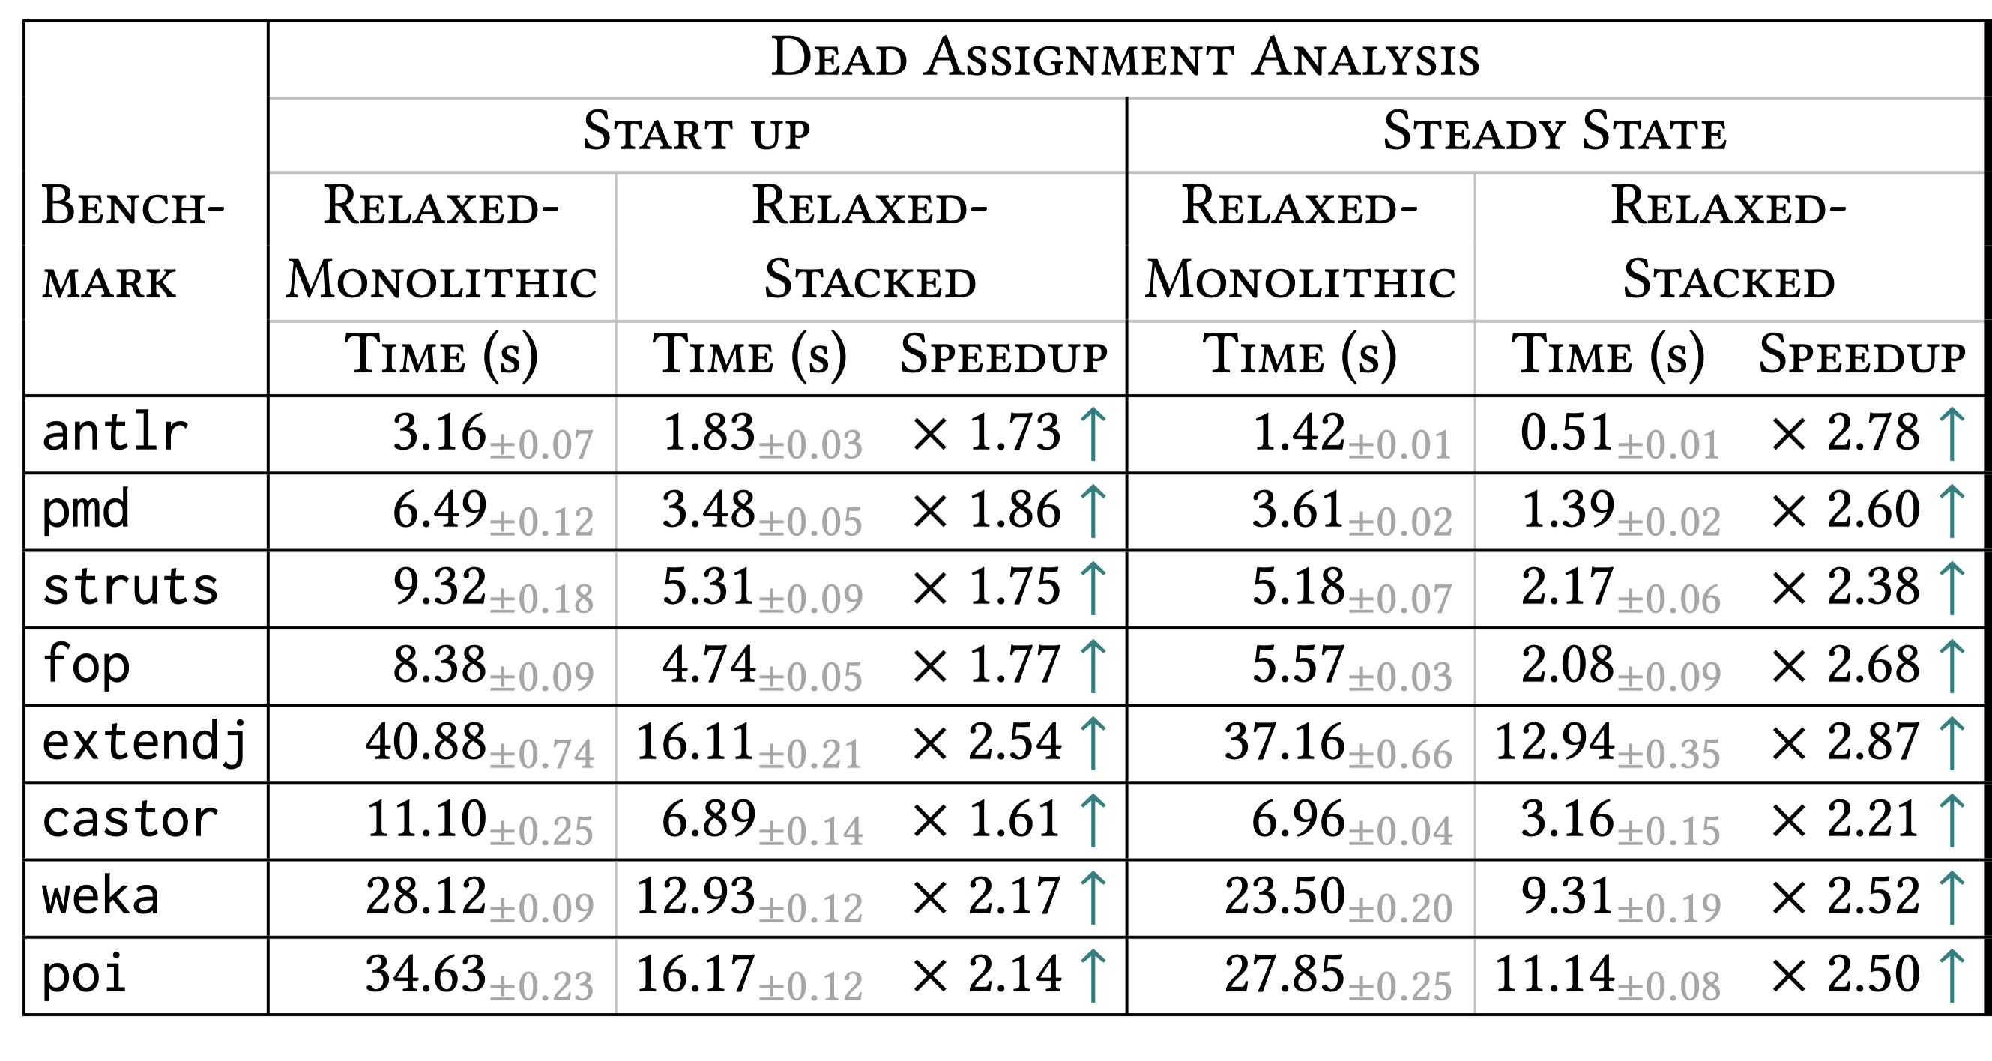


Case Study: IntraJ Static Analyser
Goal: Compute intraprocedural null-pointer dereference analysis for Java program
Comparison: RelaxedMonolithic vs. RelaxedStacked
Start Up: speedup between ~7x to ~115x, with a median of ~15x.
Steady State: speedup between ~16x to ~35x, with a median of ~22x.
35
Notes:
We had to limit the evaluation to 5 minutes, otherwise we would still be here waiting
It doesn't scale up with long methods.

Slide 35
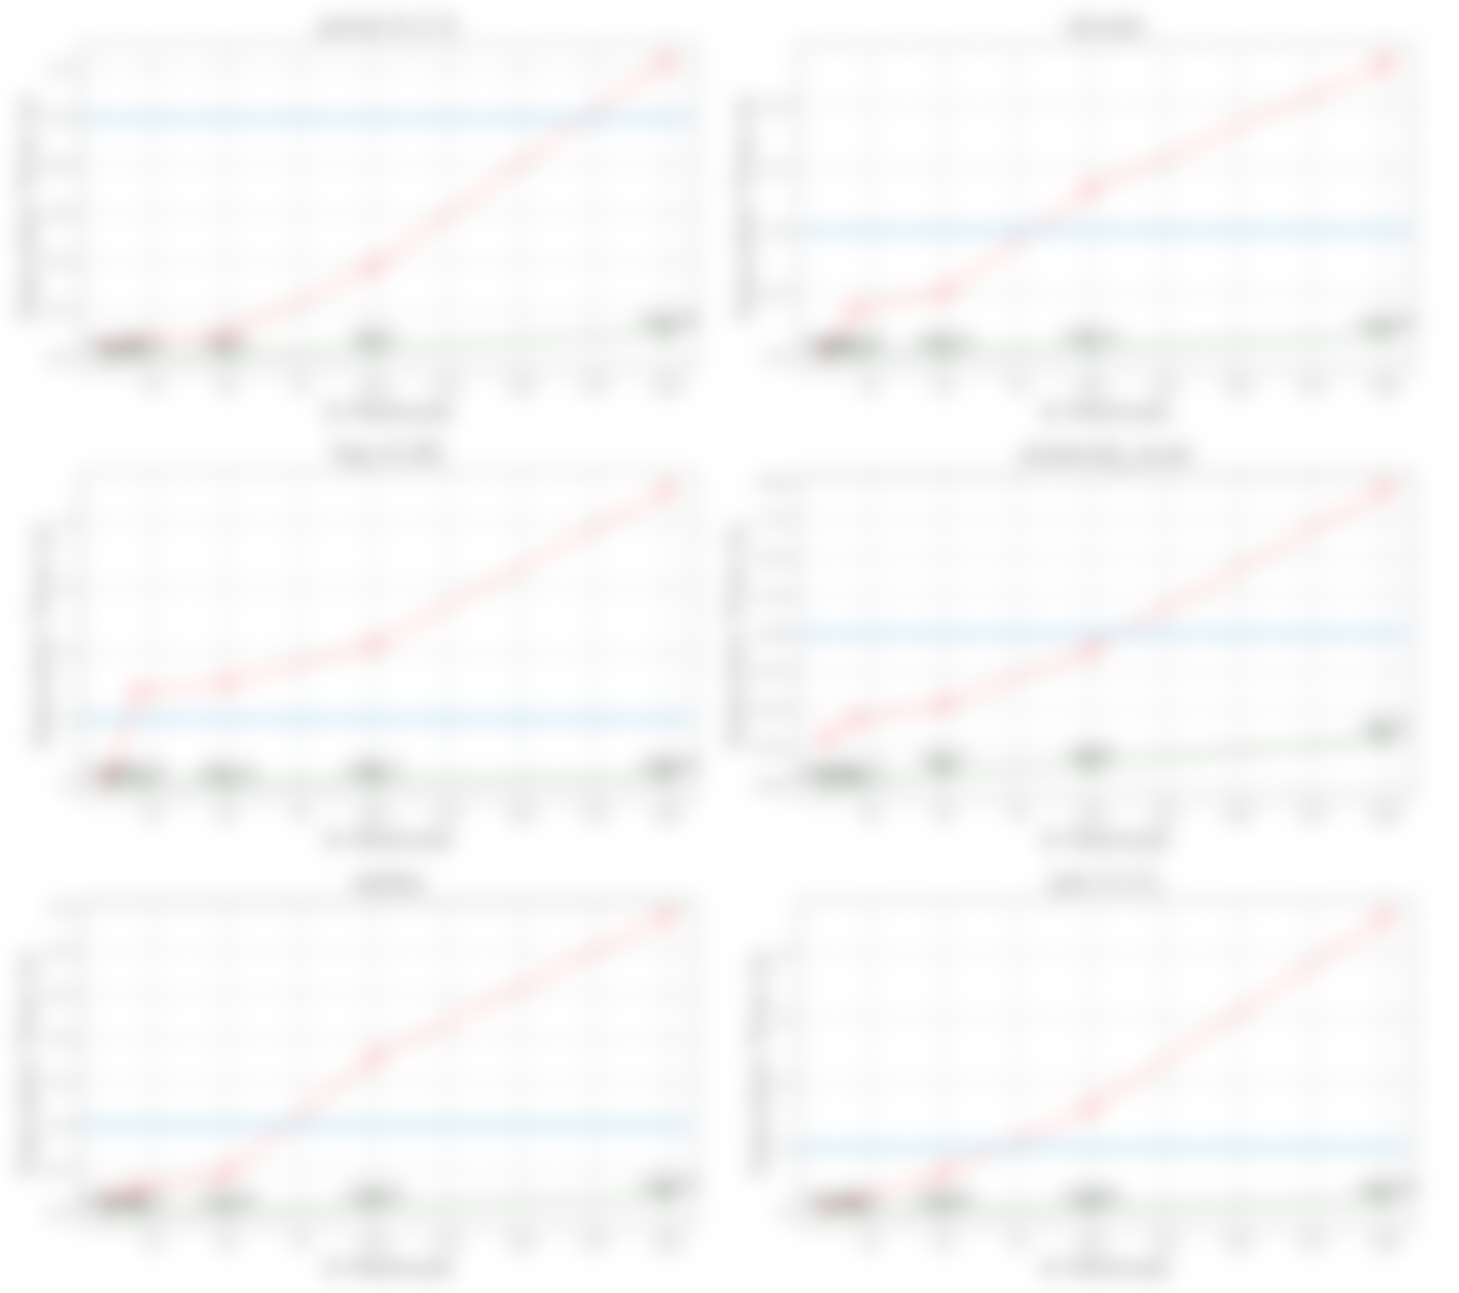
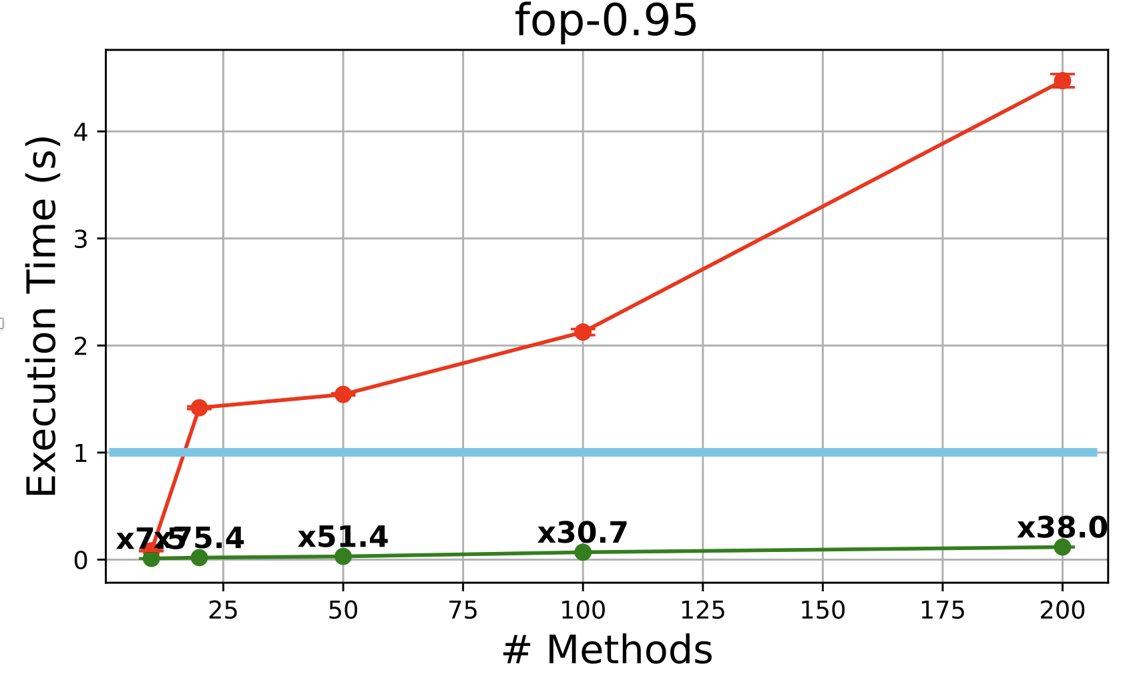
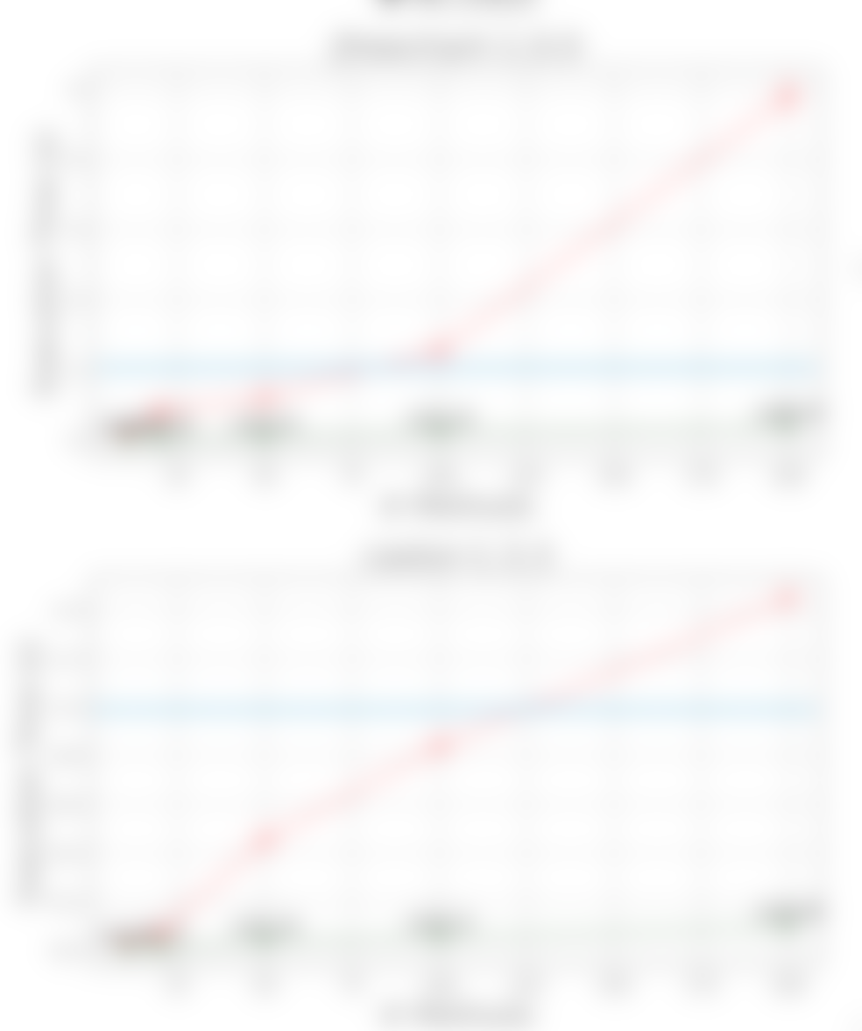
Is this fast enough?
Yes!
Randomly selected
methods:
We analysed 10 – 20 -50 - 100 – 200 methods.
Results for Null-pointer dereference
Red line: IntraJ with RelaxedMonolithic
Green line: IntraJ with RelaxedStacked
36

Slide 36

Future work
Demand-driven interprocedural Control-flow Graphs construction
Demand-driven call graphs construction
Demand-driven interprocedural dataflow analyses
Explore more way to use static analyses to enhance code generation
Improve support in JastAdd for Static Analysis:
Widening operator support
Lattice domain support
37
Notes:
Decision support tool for selecting benchmarks for specific research questions for Java
Separate future work and separate artifact from paper.
SRC programming 2024
Remove graph.

Slide 37






My Contributions
A Precise Framework for Source-Level Control-Flow Analysis
Idriss Riouak, Christoph Reichenbach, Görel Hedin, and Niklas Fors, SCAM 2021
IntraJ: An On-Demand Framework for Intraprocedural Java Code Analysis
Idriss Riouak, Niklas Fors, Görel Hedin and Christoph Reichenbach, Journal on Software Tools for Technology Transfer
JFeature: Know Your Corpus
Idriss Riouak, Görel Hedin, Christoph Reichenbach, and Niklas Fors, SCAM 2022
THANK YOU FOR YOUR ATTENTION!
Efficient Demand Evaluation of Fixed-Point Attributes Using Static Analysis
Idriss Riouak, Niklas Fors, Jesper Öqvist, Görel Hedin, and Christoph Reichenbach, SLE 2024
1st Place ACM SRC <Programming> 2024
Distinguished Paper Award
Artifact related to Paper I, was submitted to the ROSE festival 2021, receiving:
Open Research Object
Research Objects Reviewed
Artifact related to Paper III, was submitted to the ROSE festival 2022, receiving:
Open Research Object
Artifact related to Paper IV, was submitted to the SLE Artifact Evaluation Committee, receiving:
Artifact Available
Artifact Evaluated - Reusable
Distinguished Artifact Award
Model: Brioche
38

Slide 39
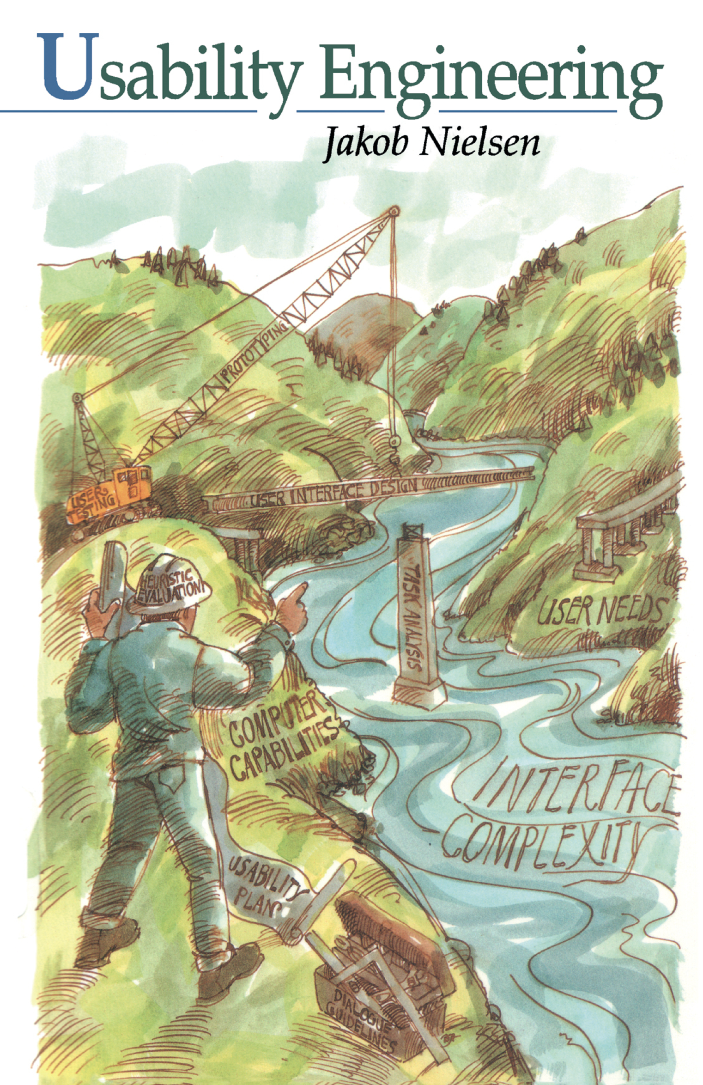
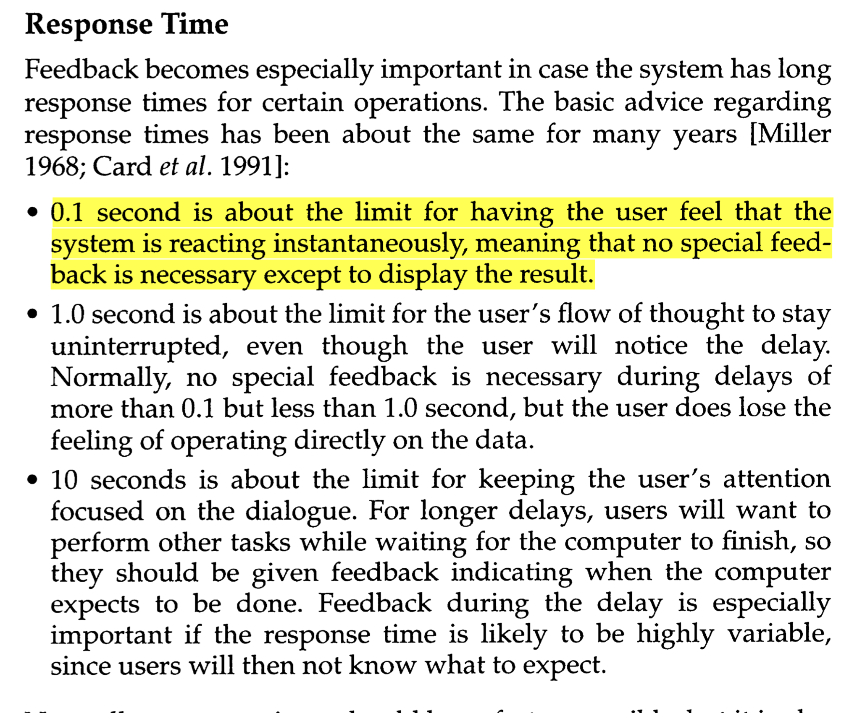
Why 0.1 Seconds ?
Page 135
Nielsen, J.: Usability engineering. Morgan Kaufmann (1994)

Slide 40
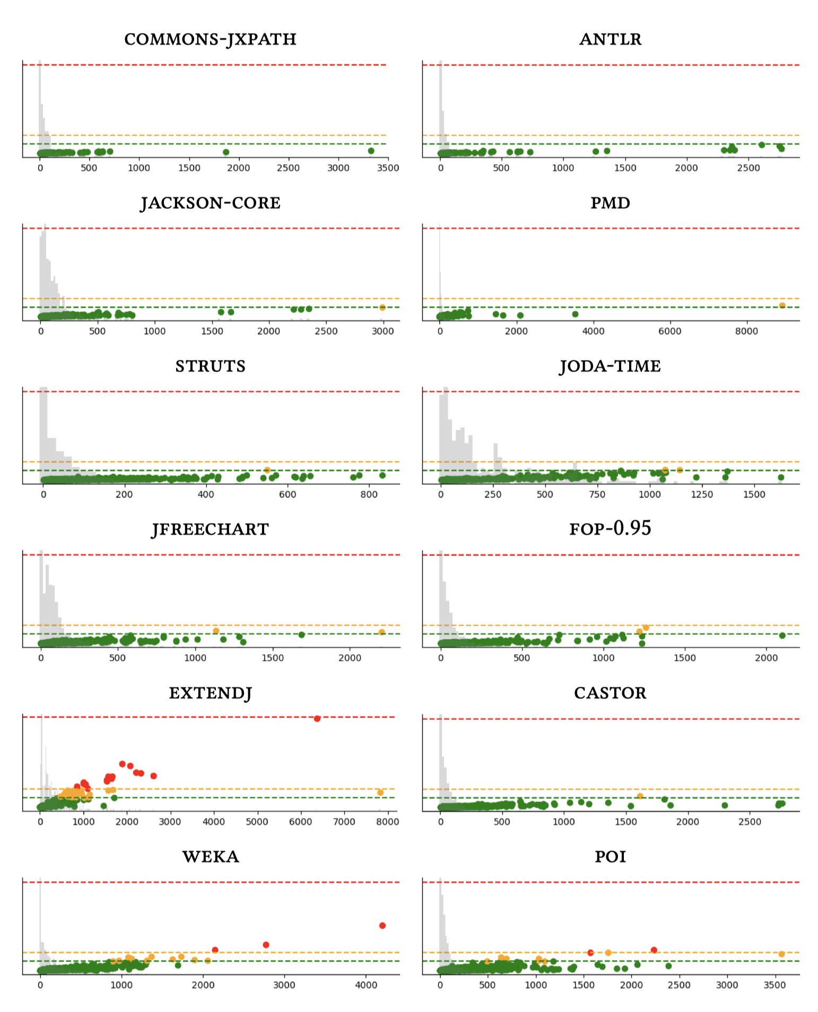
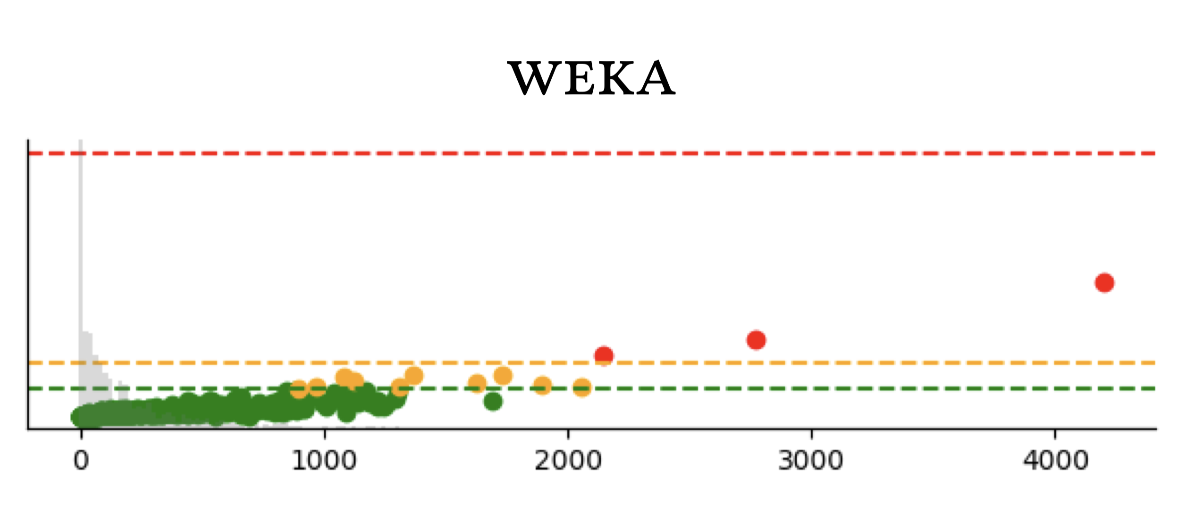
Evaluation Results
We analysed all the compilation units
Results for Null-pointer dereference
1.0
0.2
0.1

Slide 41
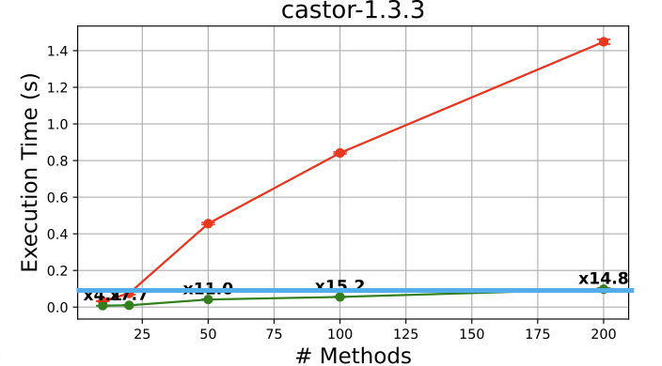
Evaluation results
We analysed all the compilation units
Results for Null-pointer dereference

Slide 42
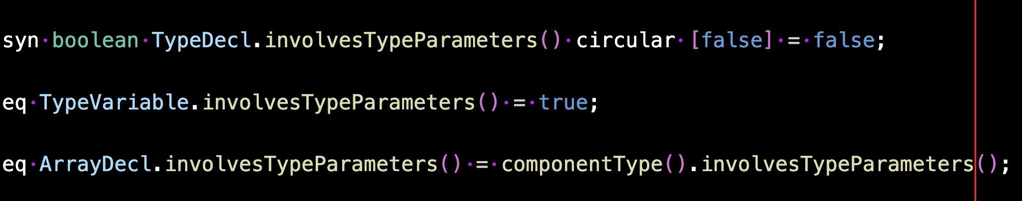
Evaluation results
The attribute equation TypeDecl.involvesTypeParameters is now cached as it has been identified as safe for caching. Notice that this attribute was declared as circular.
IntraJ: 139 attributes reclassified, including 9 reclassified from Circular to Non-circular.
ExtendJ: 194 attributes reclassified, including 7 reclassified from Circular to Non-circular.
LL(1): 7 attributes reclassified, including 2 reclassified from Circular to Non-circular.

Slide 43
Attributes Misclassification
isDead
NC
isDead
C
BasicStacked:
RuntimeException, e.g., StackOverflow
Performance degradation
RelaxedMonolithic/RelaxedStacked
RuntimeException, e.g., StackOverflow
C
in
out
NC
C
in
out
C
gen
kill
succ
gen
kill
succ
NC
NC
NC
C
C
C
isDead
A
A
in
out
A
gen
kill
succ
A
A
A

Slide 44
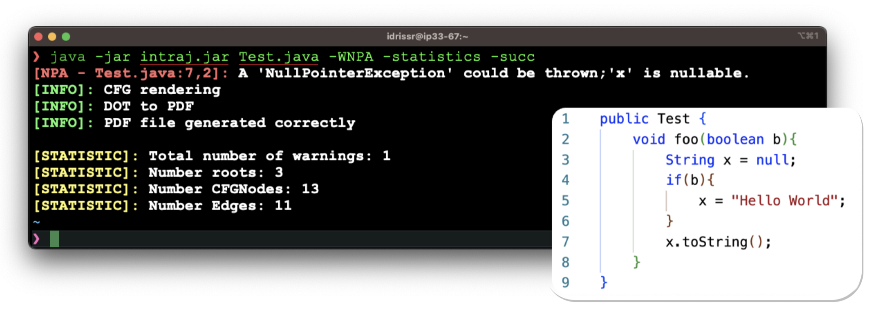
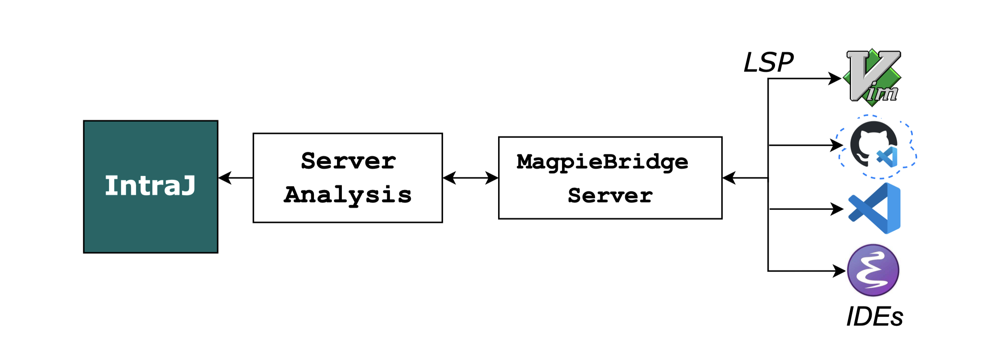
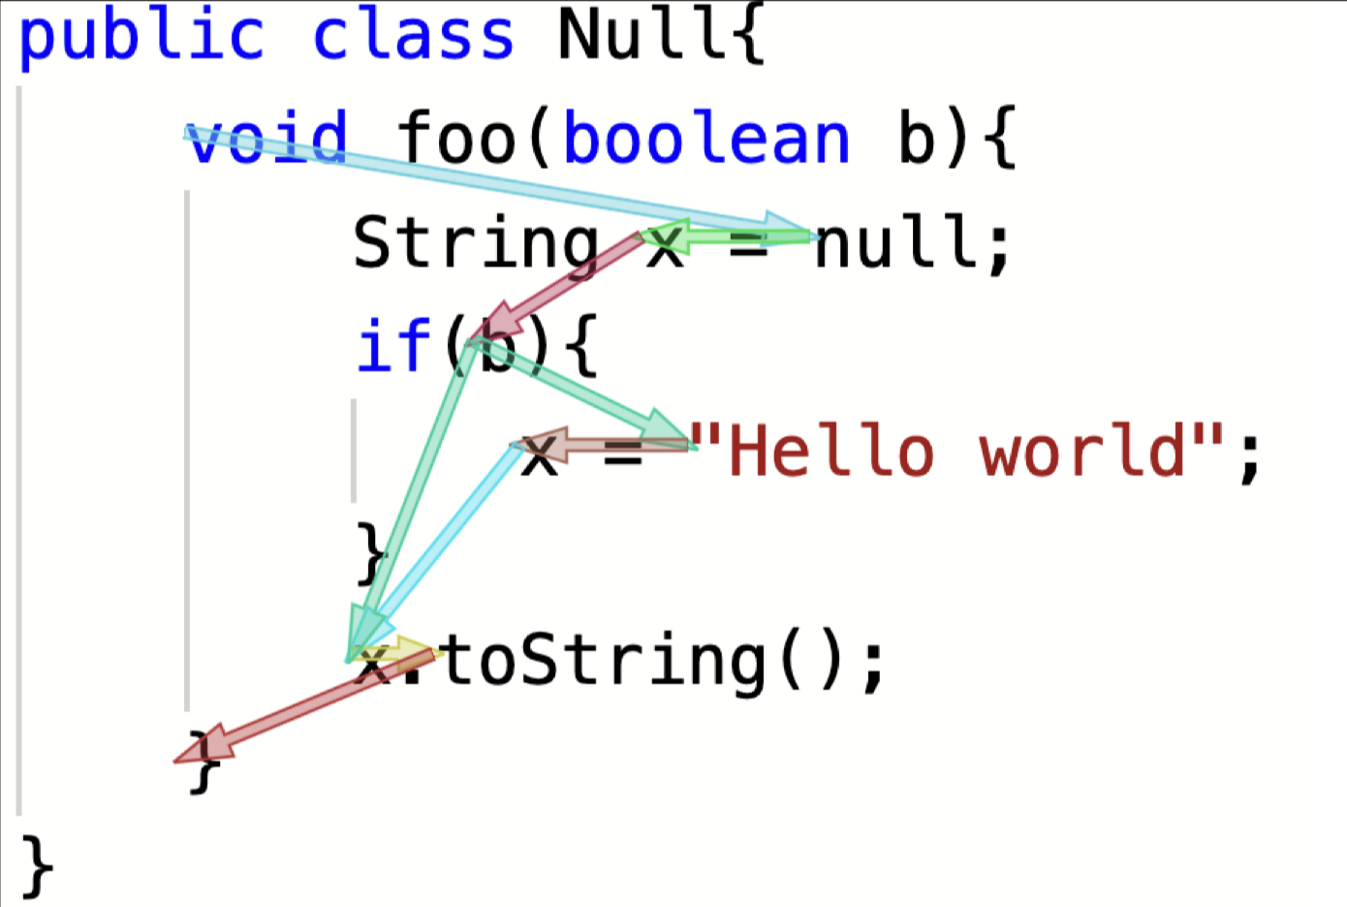
Different integrations
CLI integration
LSP integration using MagpieBridge
Codeprober integration

Slide 45
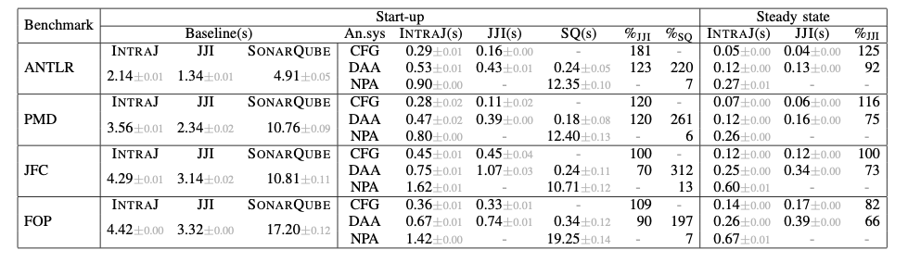
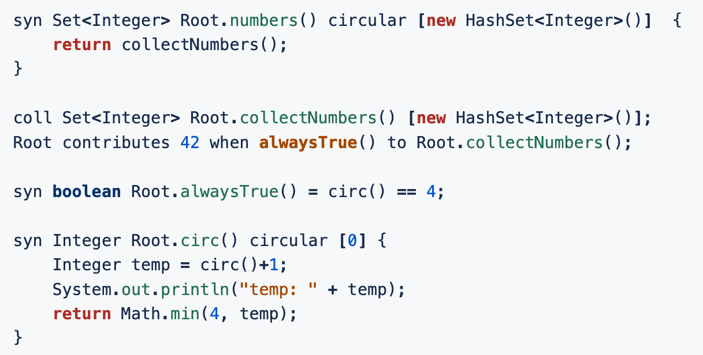
Differences between results in Paper I, Paper II, and Paper IV
Paper I: we first compute semantic analysis and then the dataflow analyses
Buggy version of collection attributes: Cache too early.
Contribution has 2 (actually 3) computed values:
42: the value we want to add to the collection.
alwaysTrue(): the condition.
reachable(): contribute to each element in reachable().
None of these values can be cached—yet they were cached.

Slide 46
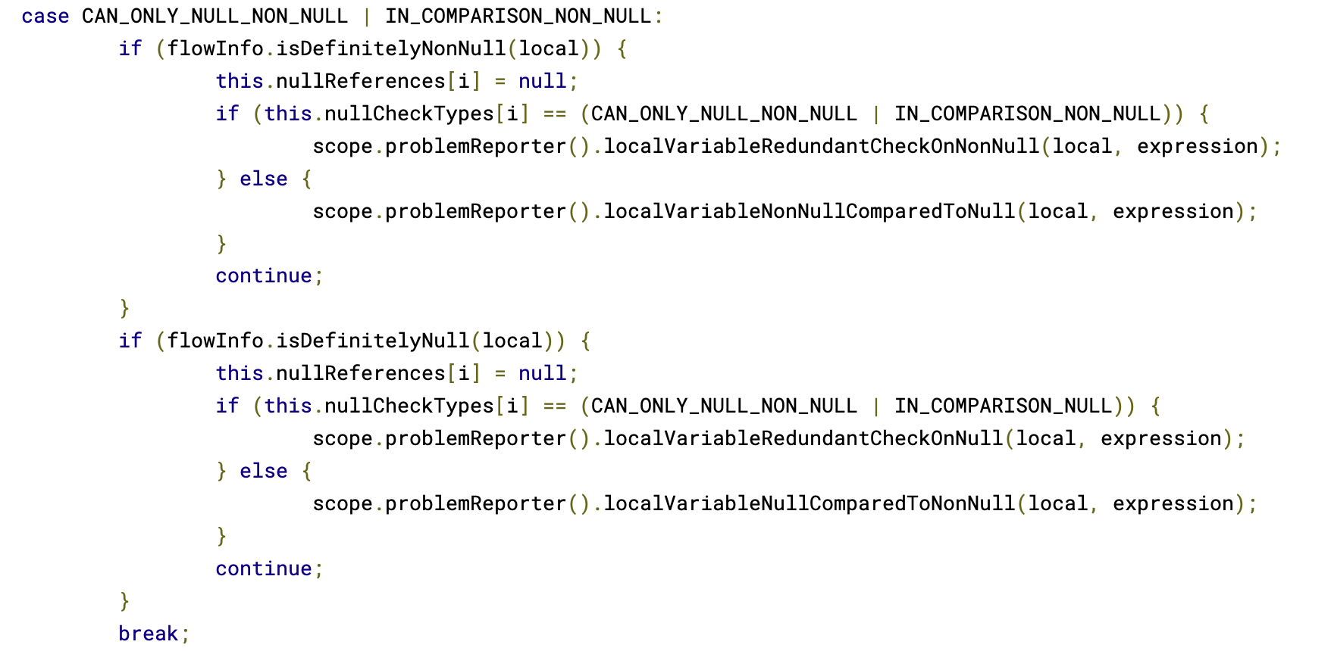
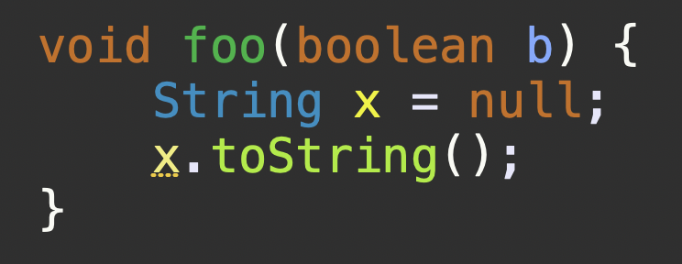
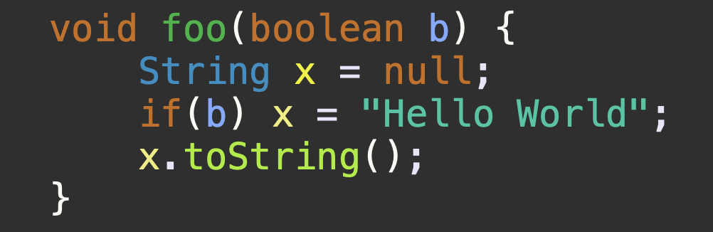
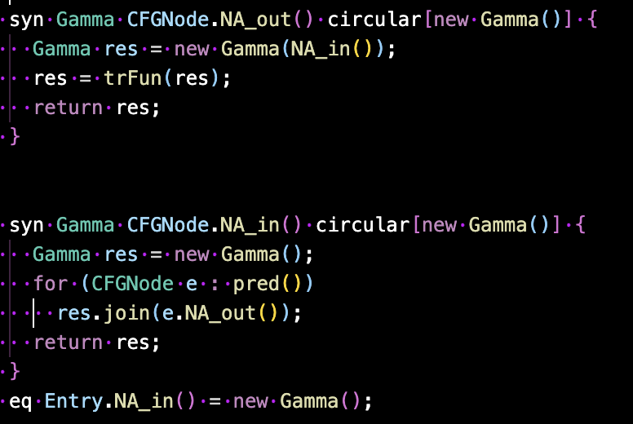
Related work: Eclipse
Control-flow sensitive
Null-pointer Exception analysis.
No fixed-point computation!
Very optimistic!
Null within try-blocks:
376 LOC
Null Propagation:
451 LOC
NullAnalysis.jrag: 188LOC

Slide 47
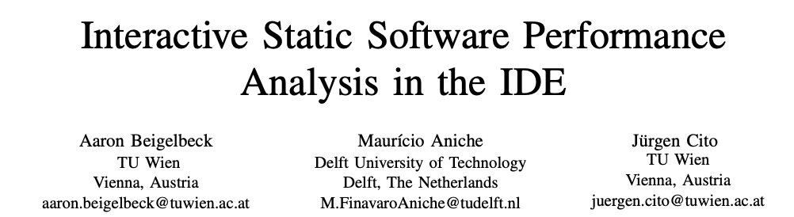


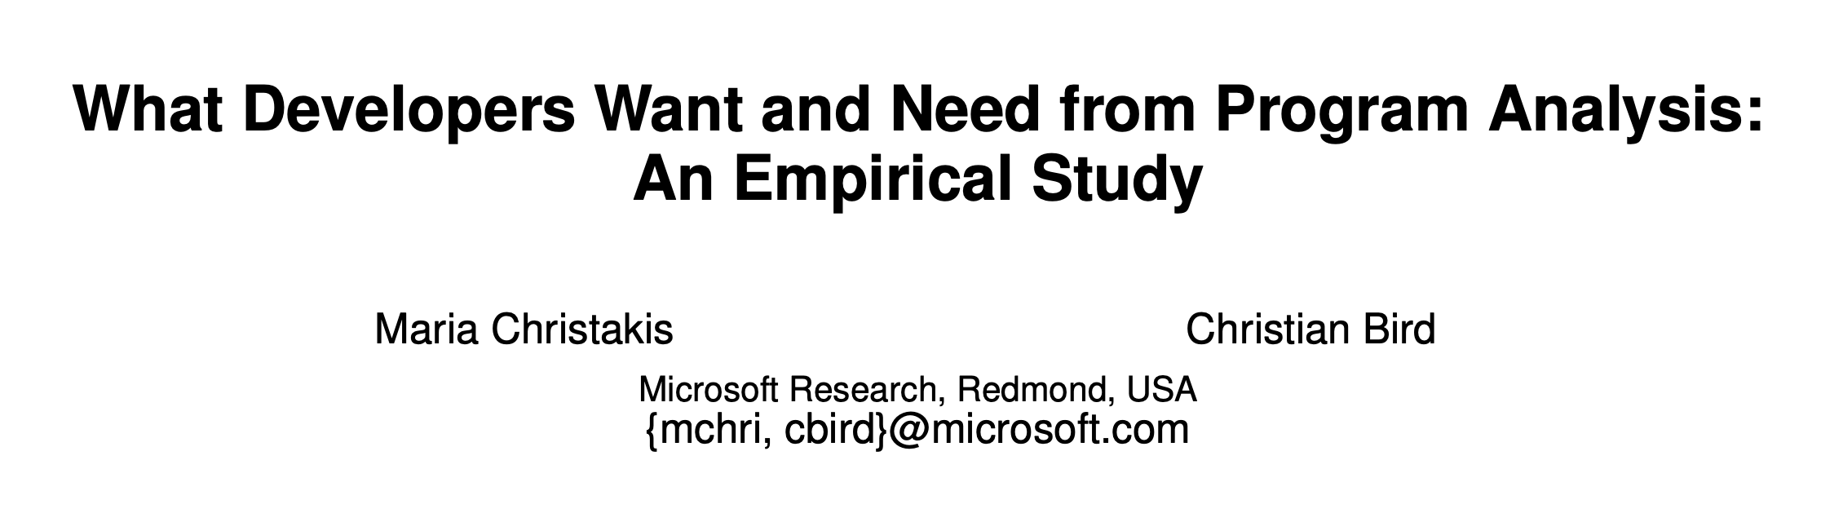
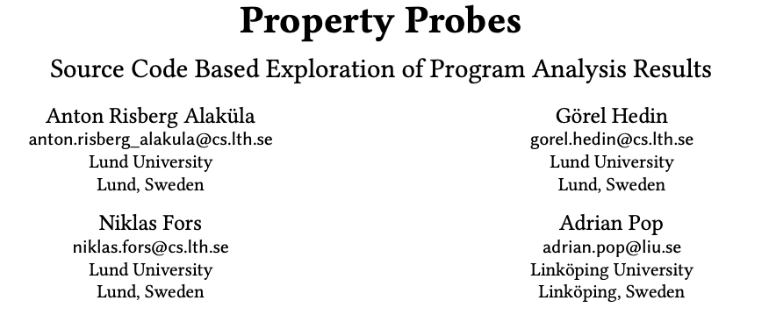


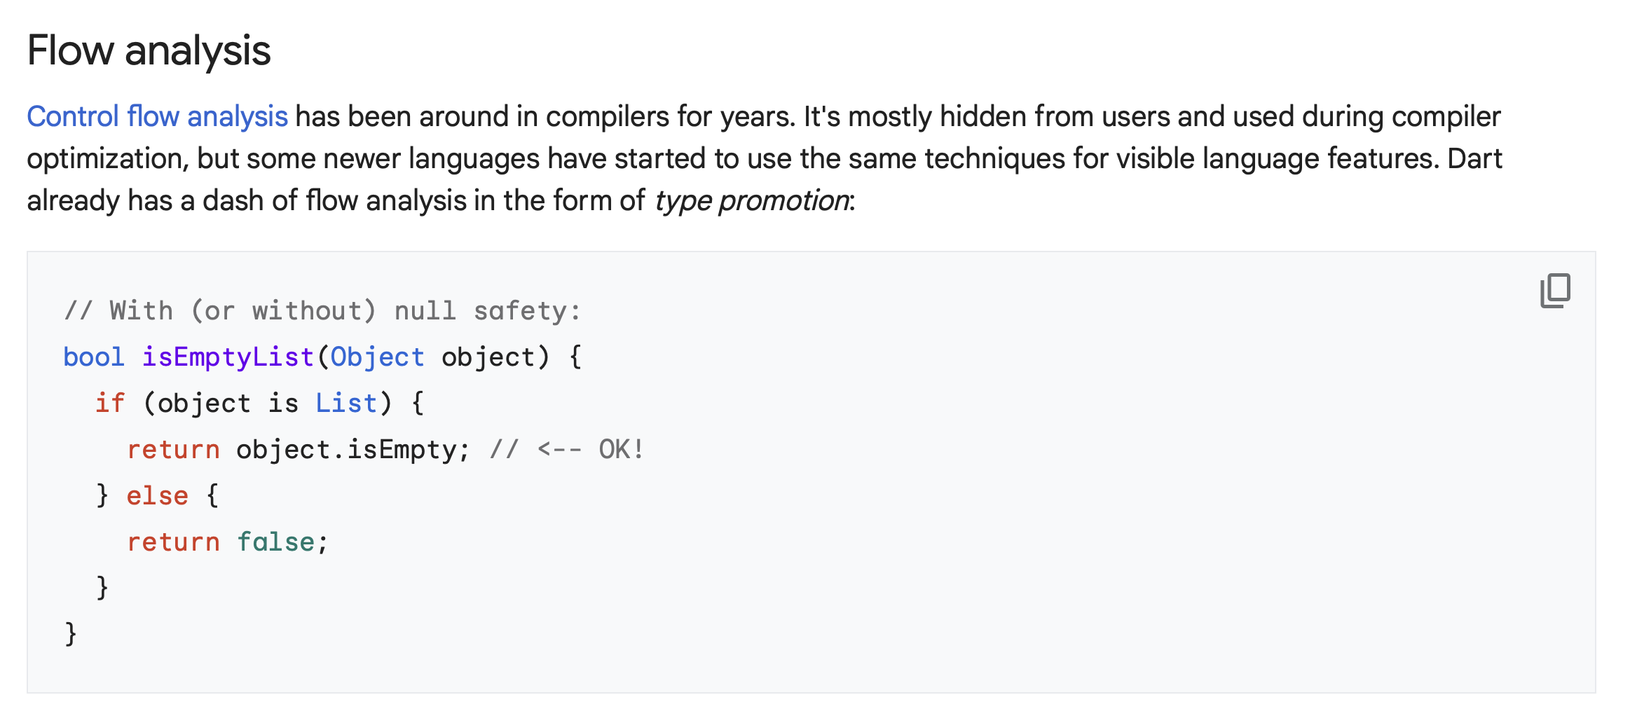


Related work: IDE Integration

Slide 48


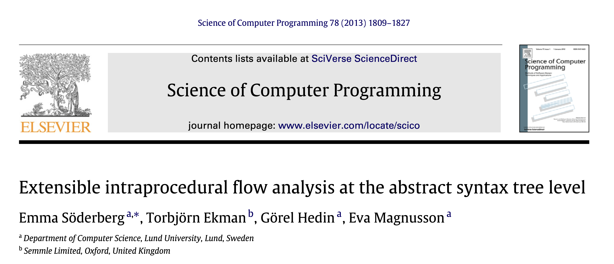

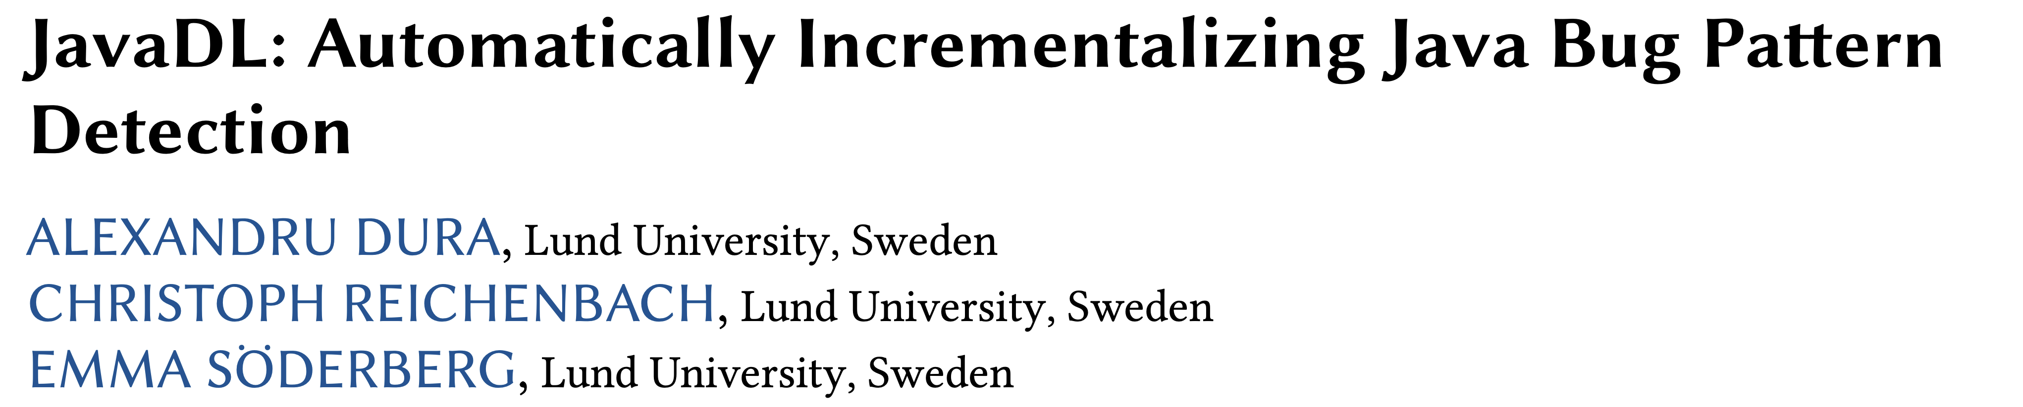
Related work: CFG Representation

Slide 49
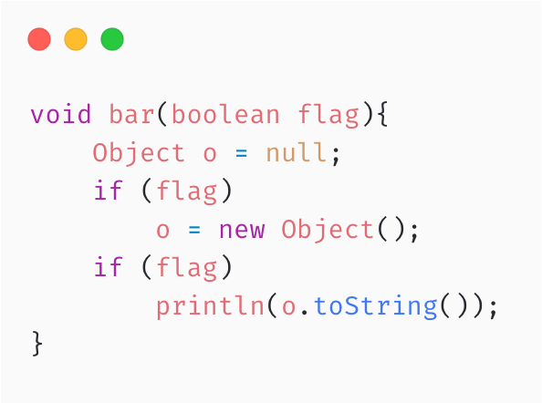

Paper I & 2: Limitations
No support for “complex” features:
Reflection
JNI
Code generation at runtime, dynamic loading
The CFG is not sound:
We take in consideration paths of checked/unchecked exceptions that are explicitly thrown.
Runtime Exceptions like StackOverflow, IndexOutOfBound are not represented in the CFG.
Lack of Context
Sensitivity
Interprocedural
knowledge
Notes:
Add slide with with FP for SonarQube

Slide 50



SonarQube: Dead Assignment Analysis Precision
⚠️
⚠️
⚠️
Notes:
Add slide with with FP for SonarQube

Slide 51

Direct impact
Potential impact
Many different projects use RAGs:
ExtendJ
IntraJ
JavaDL – Datalog static analyser
Progger – Compiler Tracer and Debuggin tool
Bloqqi - DSL used @ ABB
Used @ Modelon
CAT – Call Graph Analysis Tool
…
Other Attribute Grammars Systems that could
benefit from this:
Silver (Java)
Haskell library
…
Query based compiler, where caching is essential:
Rustc compiler is moving towards that direction
Roslyin: C# compiler is using a concept very similar
Attributes

Slide 52

Case Study 1: LL(1) parser construction
Goal: Compute Nullable, First and Follow sets.
Background: This case study was based on the artifact from Magnusson (2003). (Make Your Research Open). Comparison: RelaxedStacked vs. BasicStacked vs. RelaxedMonolithic.
RelaxedStacked is as fast as the BasicStacked.
And it ~2.8x faster than the RelaxedMonolithic.

Slide 53



Case Study 2: ExtendJ Java Compiler
We inspected the ExtendJ source code and found it uses very few circular attributes. Still, experiments show that our algorithm introduces no additional overhead.

Slide 54
Paper IV: Limitations
We construct the callgraph using Class Hierarchy Analysis (CHA)
More Efficient
Class Hierarchy Analysis
Rapid Type Analysis
Variable Type Analysis
Pointer Analysis
More Precise
isConst
syn boolean Expr.isConst() =
getLeft().isConst() && getRight().isConst()
AGNOSTIC

Slide 55

Paper IV: Limitations
We cannot decompose dynamic components
reachable
successor
CIRCULAR
AGNOSTIC
We started looking into decomposing SCC without Non-Circular attributes:
Each component has an ID
A
B
C
D
ID = 1
ID = 2

Slide 56



Use of LLMs in static analysis
LLMs, trained on a broad average of web content, excel at recognizing familiar patterns but struggle to identify novel issues in static analysis.
LLMs can assist in static analysis by:
Identifying sources and sinks for taint analysis.
Differentiating true positives from false positives, such as in spam detection scenarios.

Slide 57


Incremental and Concurrent Evaluation

Slide 58
Classify everything using static analysis
This means finding all possibly CIRCULAR attributes.
It’s possible ? Yes: if we can infer the bottom value for each possible attribute classified as CIRCULAR.
Is this convenient? I don’t think so, at least not with CHA. I believe we would encounter the same problem that BasicStacked had, i.e.,:
Some attributes exhibit circular behavior occasionally but we still pay for a costly fix-point computation.
syn NullDomain CFGNode.outNPA() circular[new NullDomain()]
{ return … }

Slide 59


Start-up vs Steady-State
Start-up: For each project, we collected 50 samples.
Steady-state: After warming up the JVM by discarding the first 24 iterations, we used the 25th iteration for measurement. This process was repeated 50 times. For a total of 1250/project.

Slide 60



Algorithms
NON-CIRCULAR
AGNOSTIC
CIRCULAR

Slide 61

Demand-driven Evaluation
Computed Attributes
CWE-476
🐞
‘x’ might be null
Queried Attribute
Not computed attribtue

Slide 62

CFG on top of the AST

